Slide 1
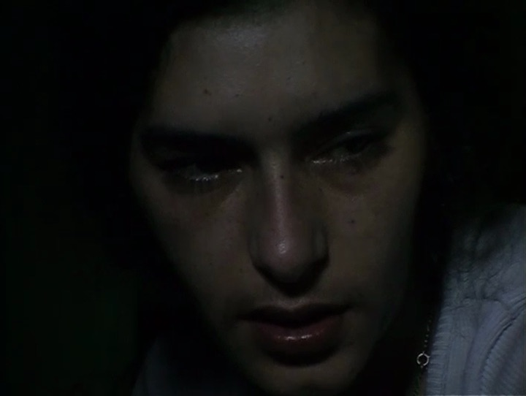
HOSPITALITY AND DOCUMENTARY LABOR
towards a “hospitable documentary”?

Slide 2
OVERVIEW
QUESTIONS OF DOCUMENTARY ETHICS
• ethics of documentary as function of Documentary Situation: the (presumably) unique relationship between apparatus (makers of documentary images) and documentary protagonist (i.e. “social actors”: objects of documentary image) that constitutes the
• Two (related) critical frameworks: (1) Labor (who is the employer? who is the worker? what constitutes “work” in doc. situation?); and (2) Hospitality (who is the host? who is the guest? what constitutes “threshold” of doc. situation?)
• No quarto da Vanda and Tierra Roja: our laboratories. History of their gestation/production; the concepts and questions each generates about the documentary situation, documentary labor, and hospitality

Slide 3
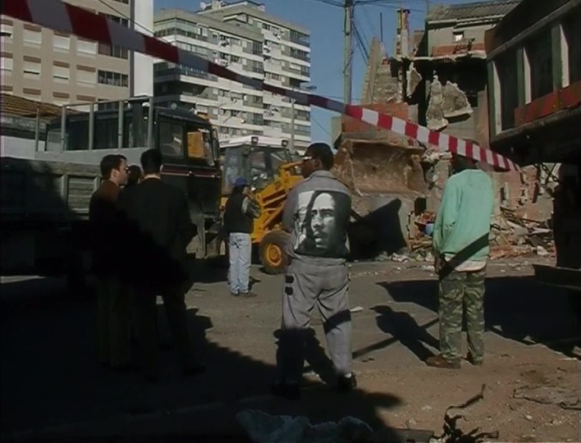
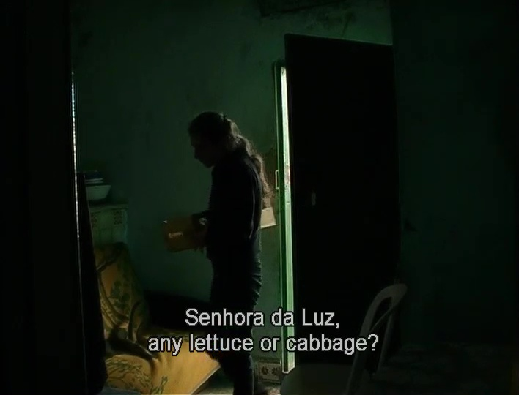
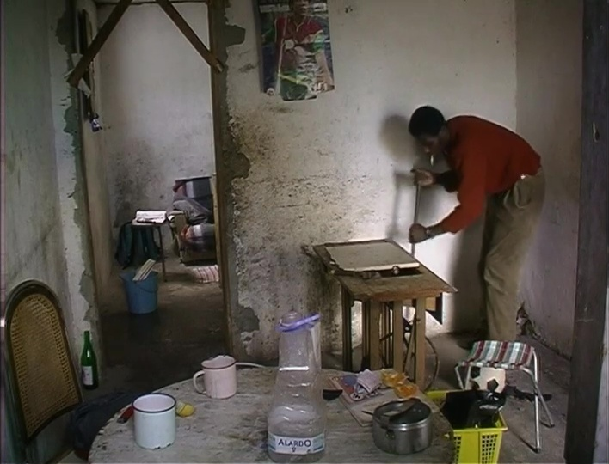
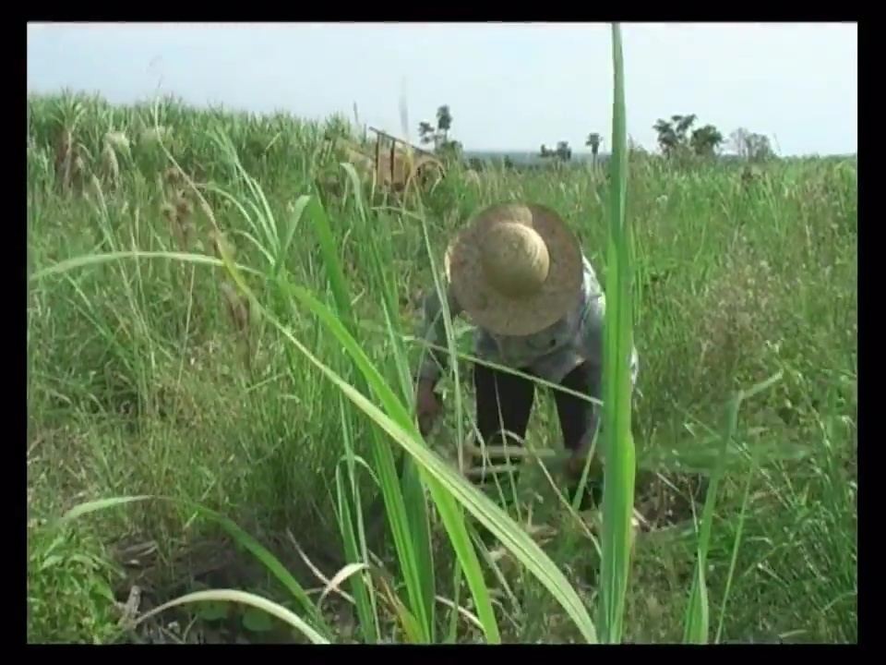
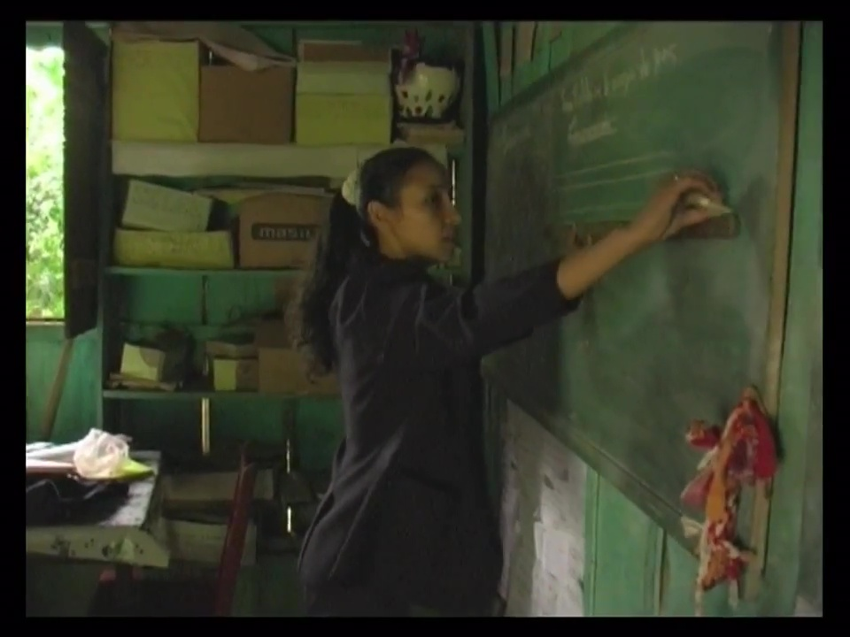
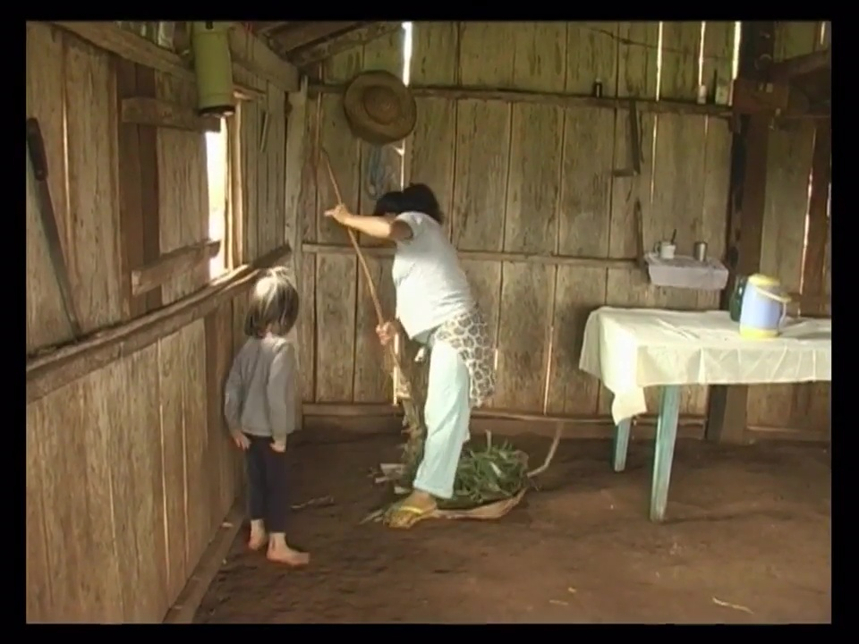
IMAGES OF documentary LABOR (?)

Slide 4
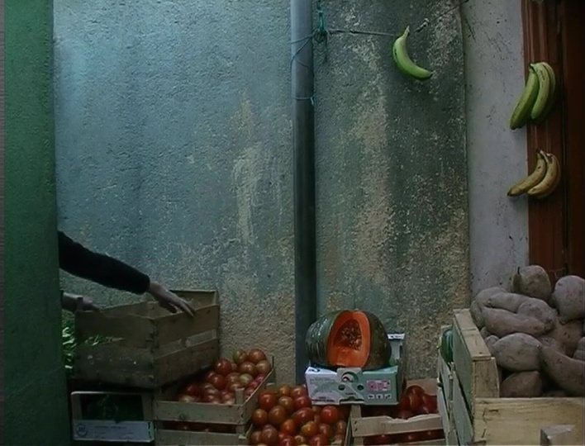
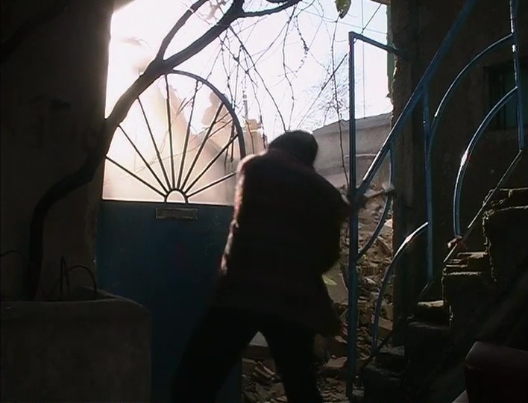
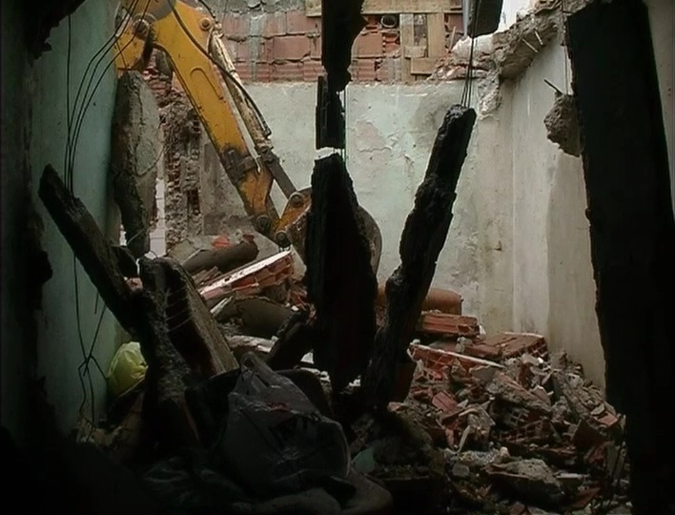
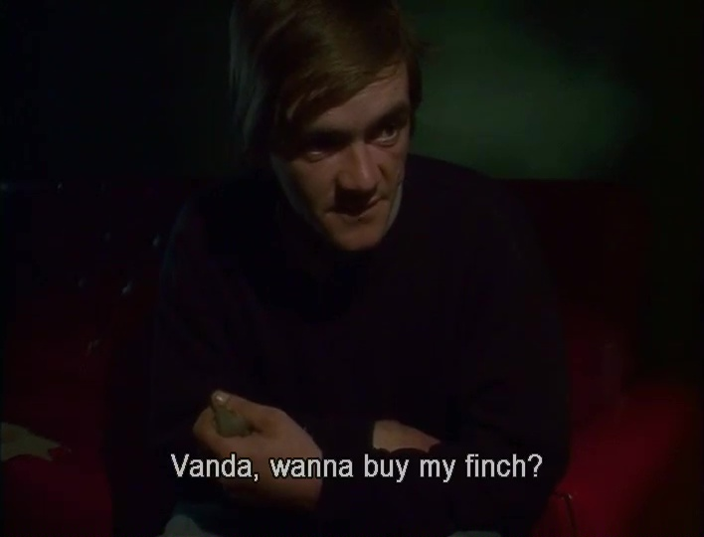
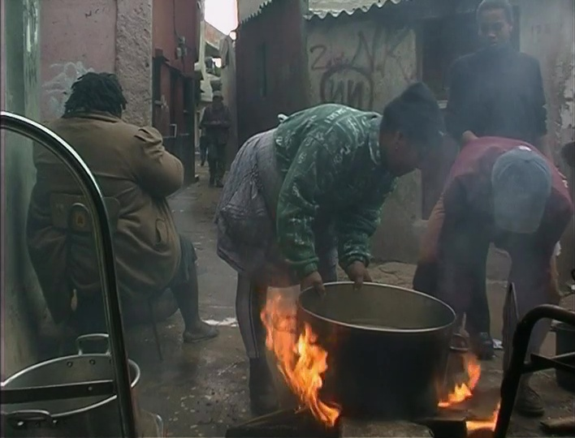
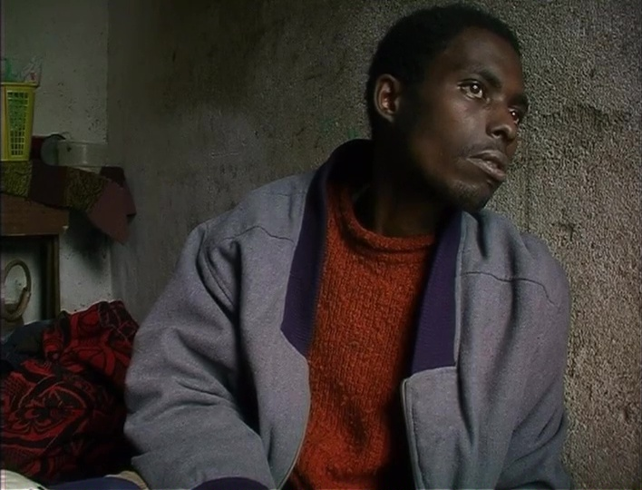
The paradoxes of documentary labor…

Slide 5
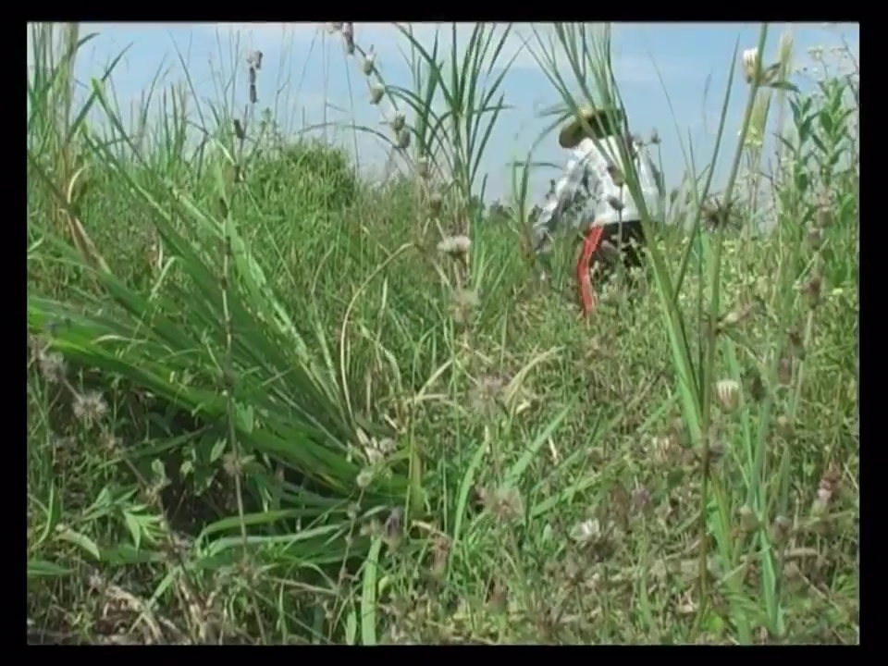
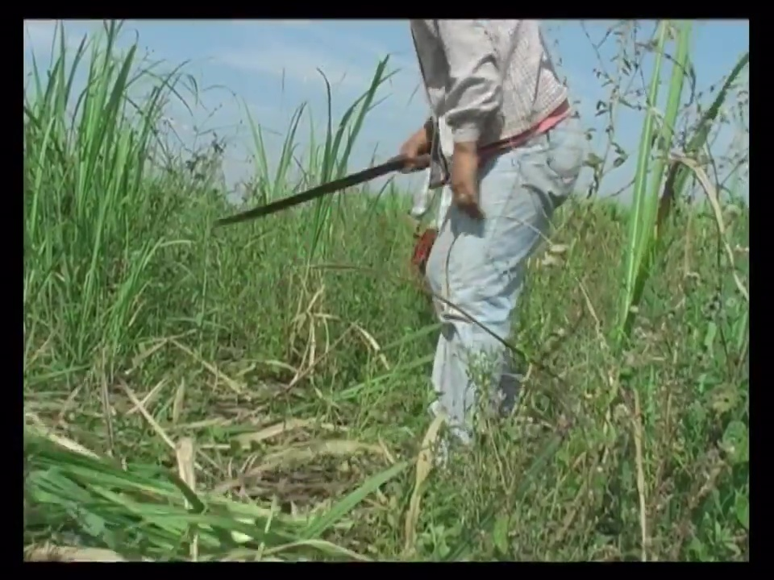
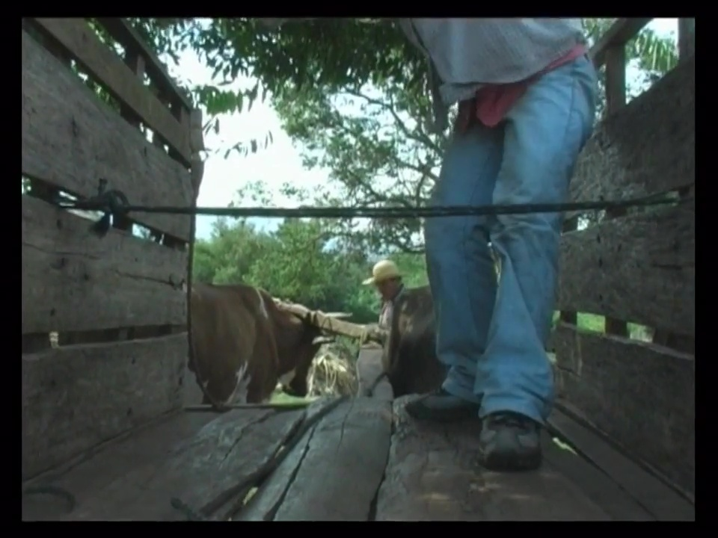
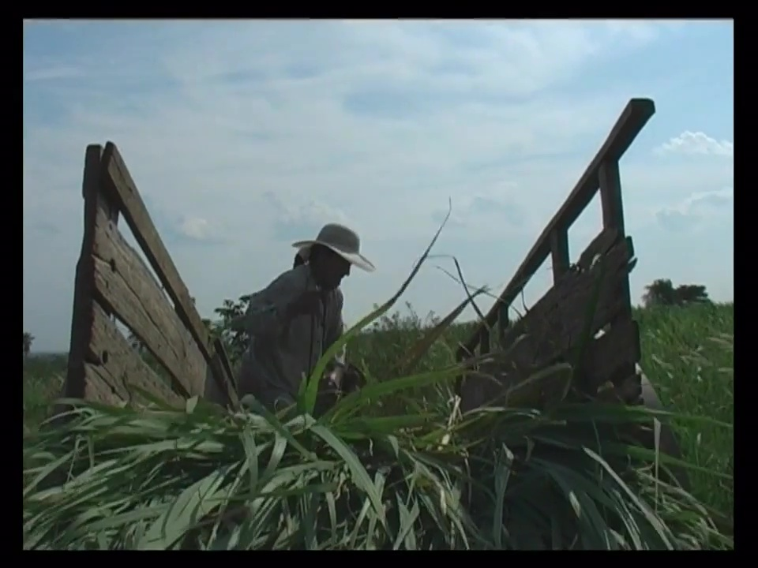
The paradoxes of documentary labor…
Framing and mise-en-scène that obstructs/distances/separates us from “hard labor”…

Slide 6
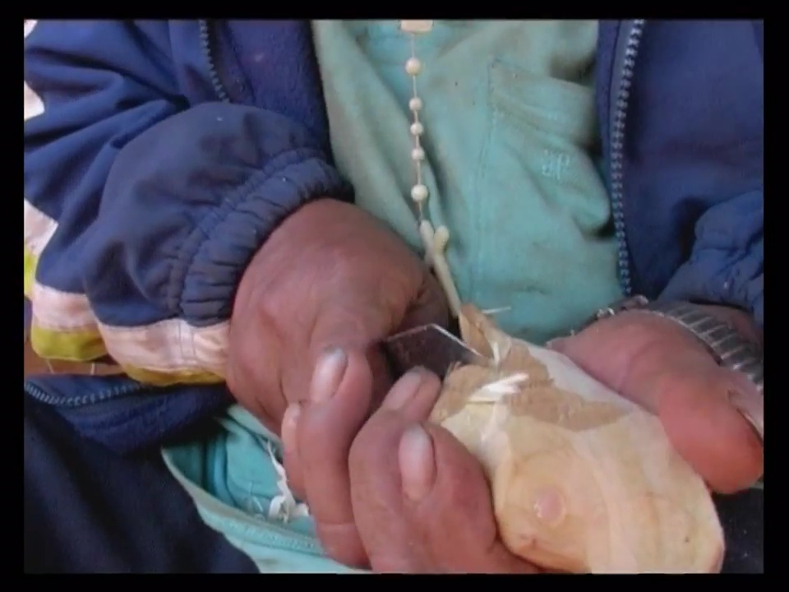
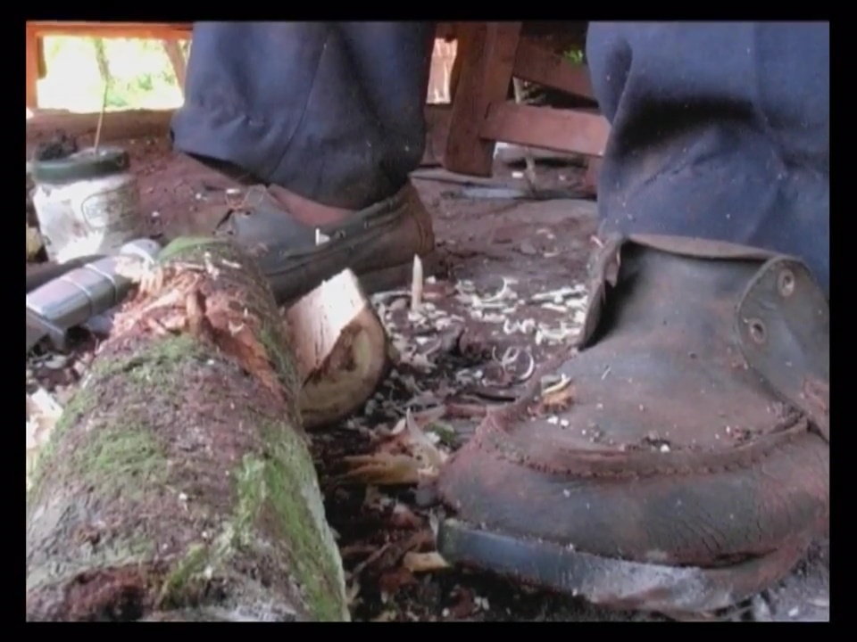
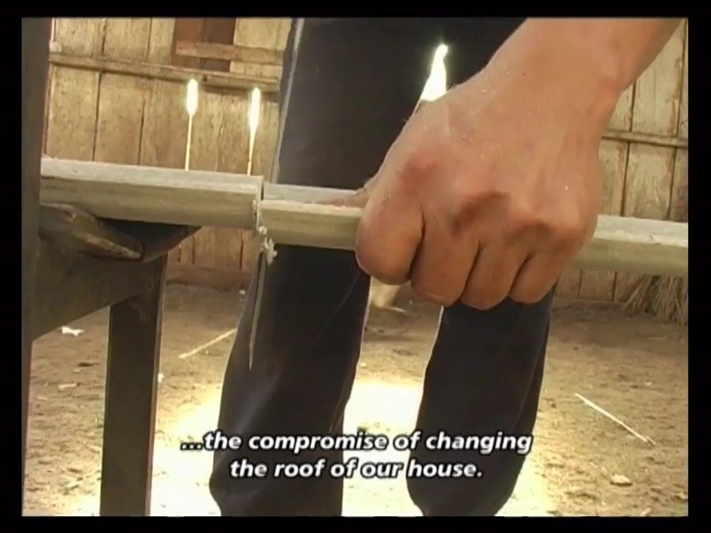
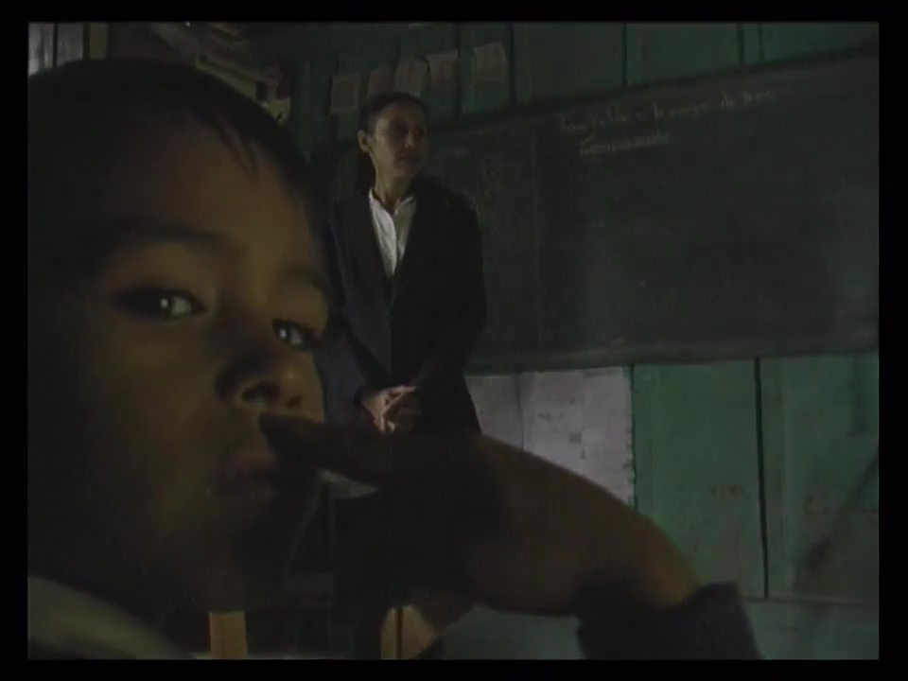
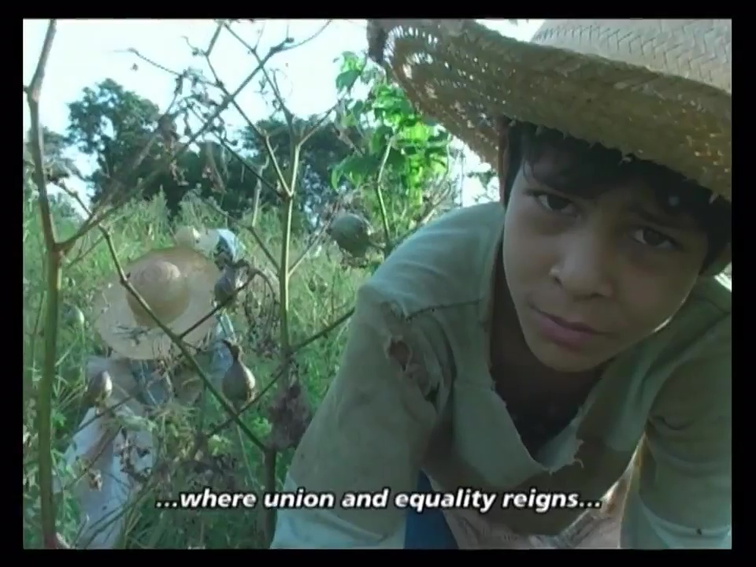
The paradoxes of documentary labor…

Slide 7
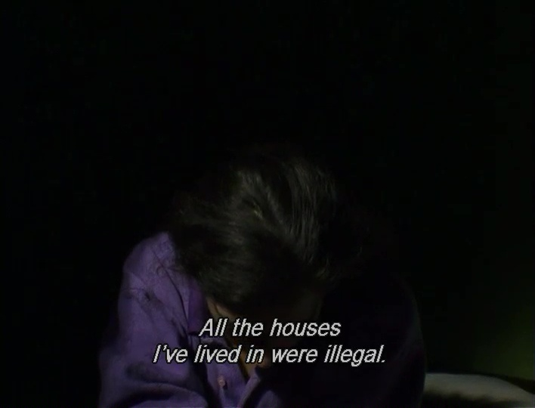
documentary hospitality. hospitable documentary?
From an ethics of labor to the ethics of hospitality
This is the paradoxical effect of what we are here calling the pervertibility, the perversion of this state violence or this right, that is always possible and in truth virtually inevitable, bound to happen: the effacement of the limit between private and public, the secret and the phenomenal, the home (which makes hospitality possible) and the violation or impossibility of home (Derrida 65).

Slide 8
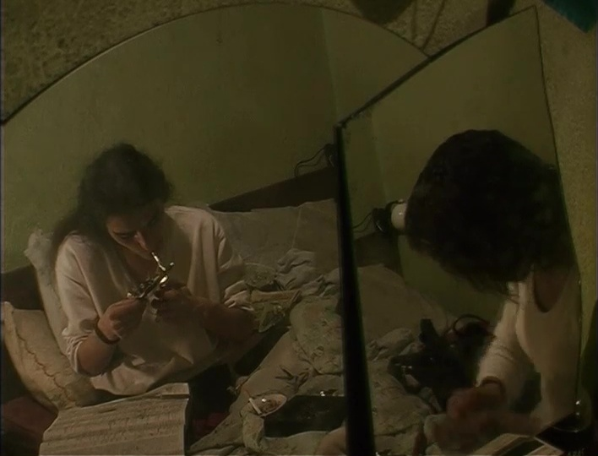
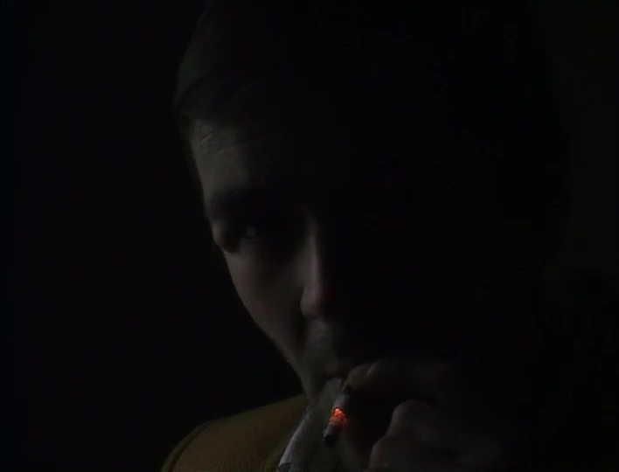
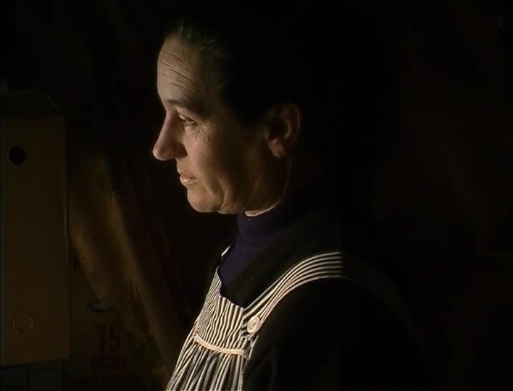
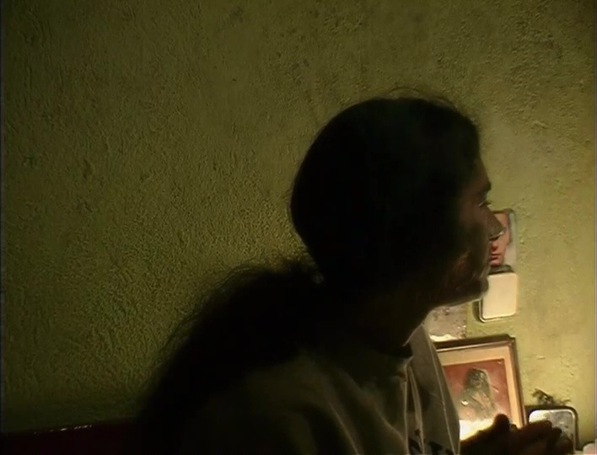
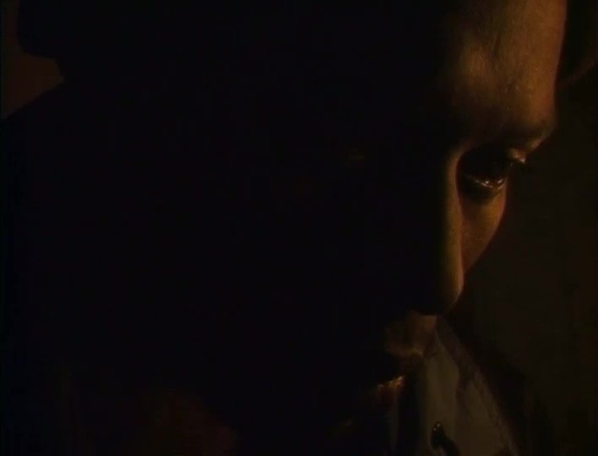
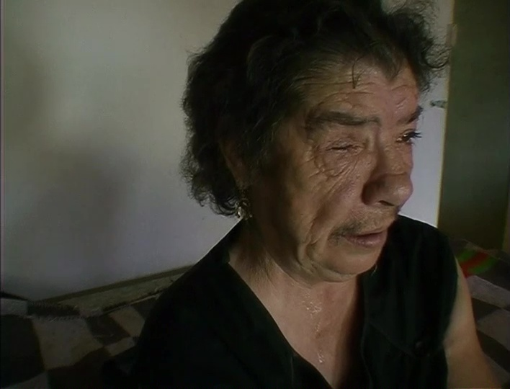
The audio-visual construction of hospitality(?)

Slide 9
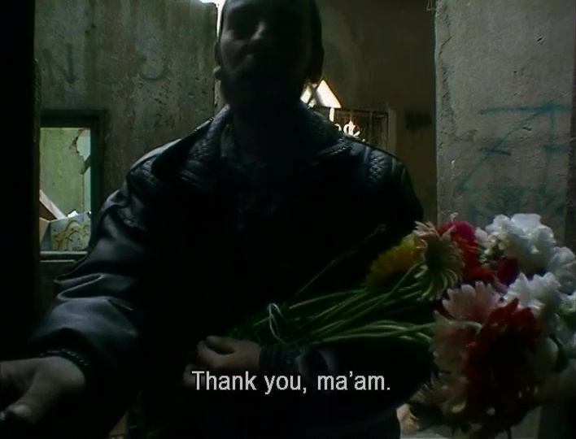
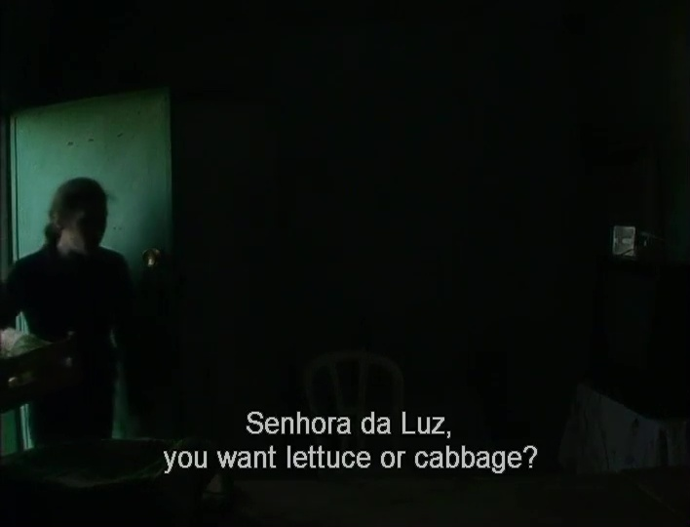
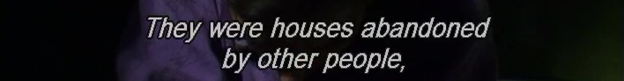
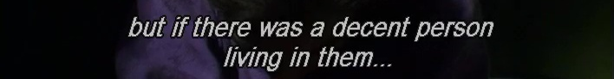
The audio-visual construction of hospitality(?)

Slide 10
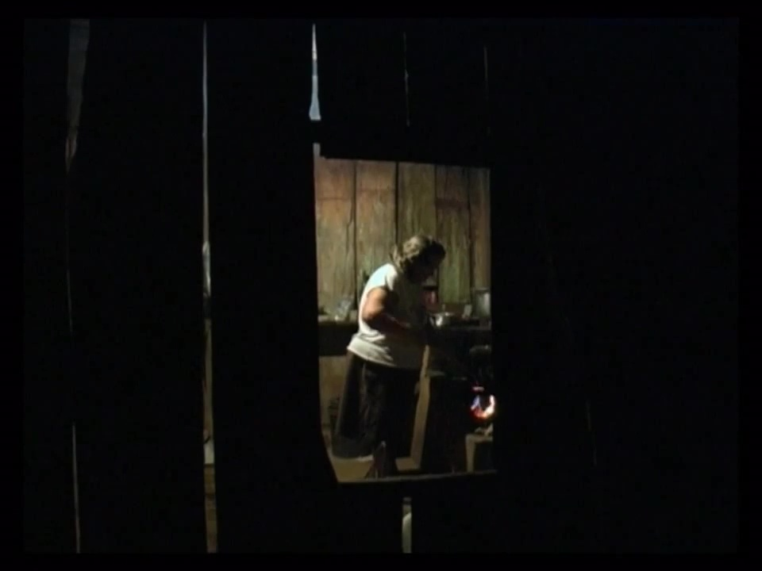
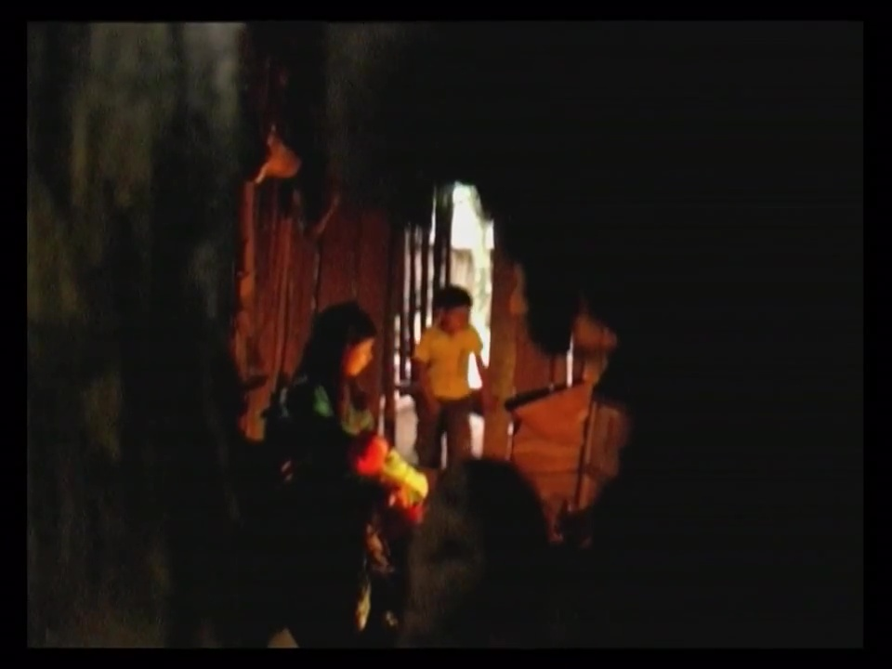
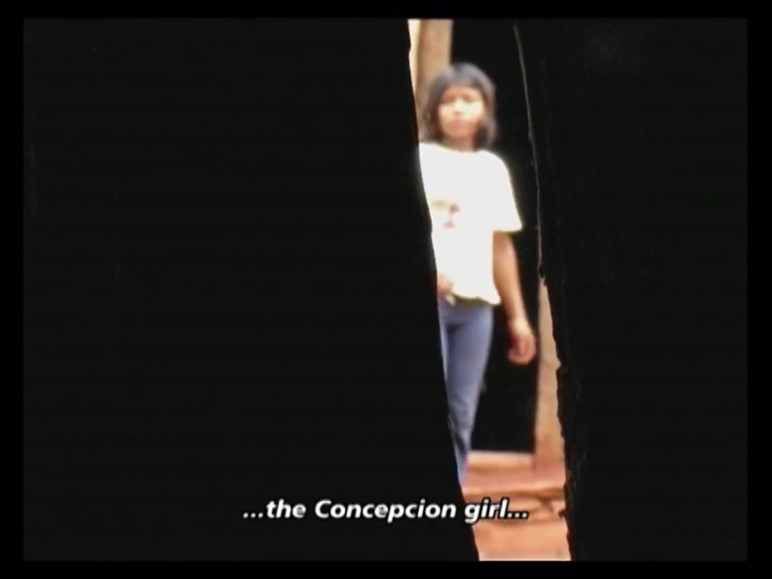
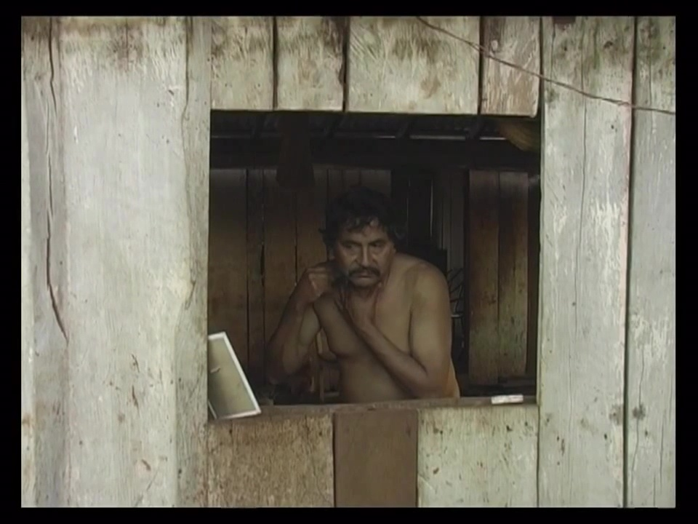
the paradoxes of hospitality
“Radical” internal frames…

Slide 11
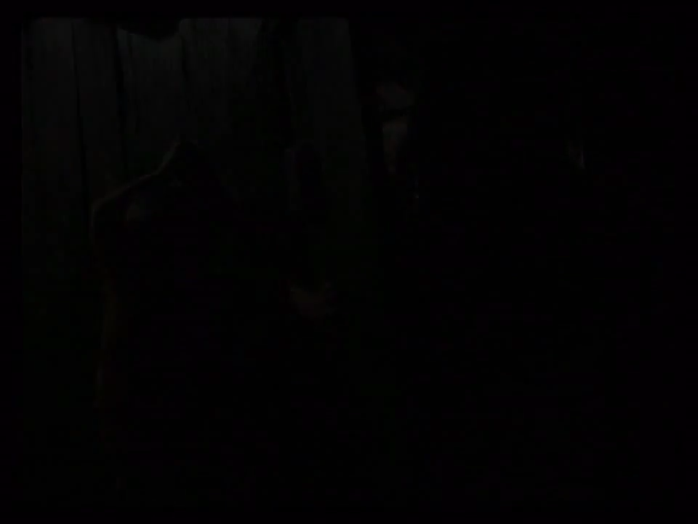
The audio-visual construction of hospitality(?)

Slide 12
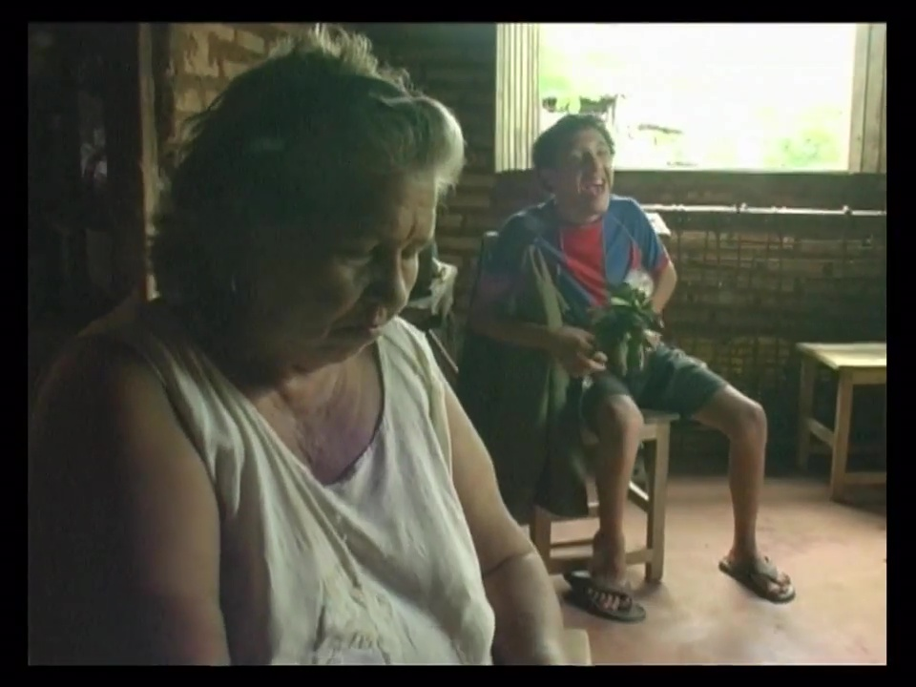
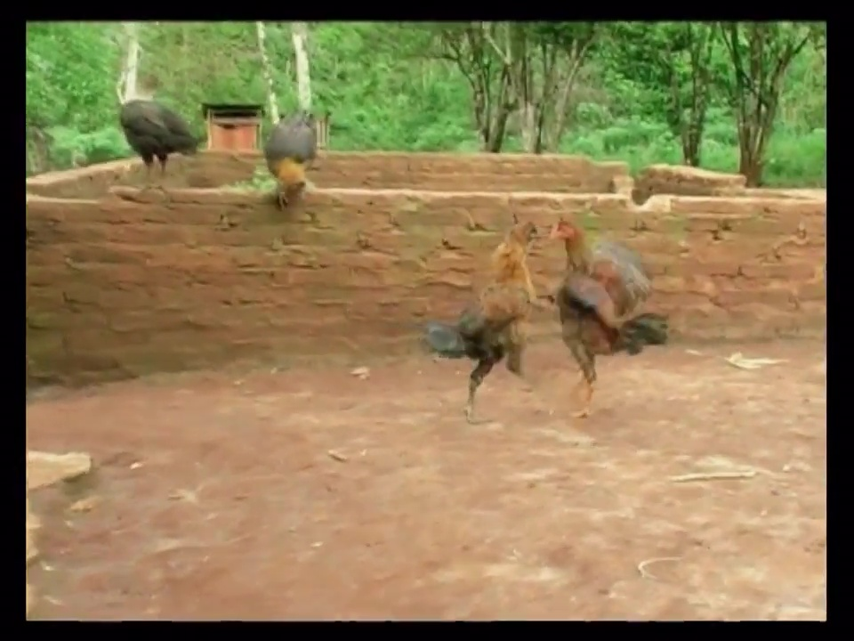
The audio-visual construction of hospitality(?)
“Inscrutable objects” in the mise-en-scène

