Slide 1
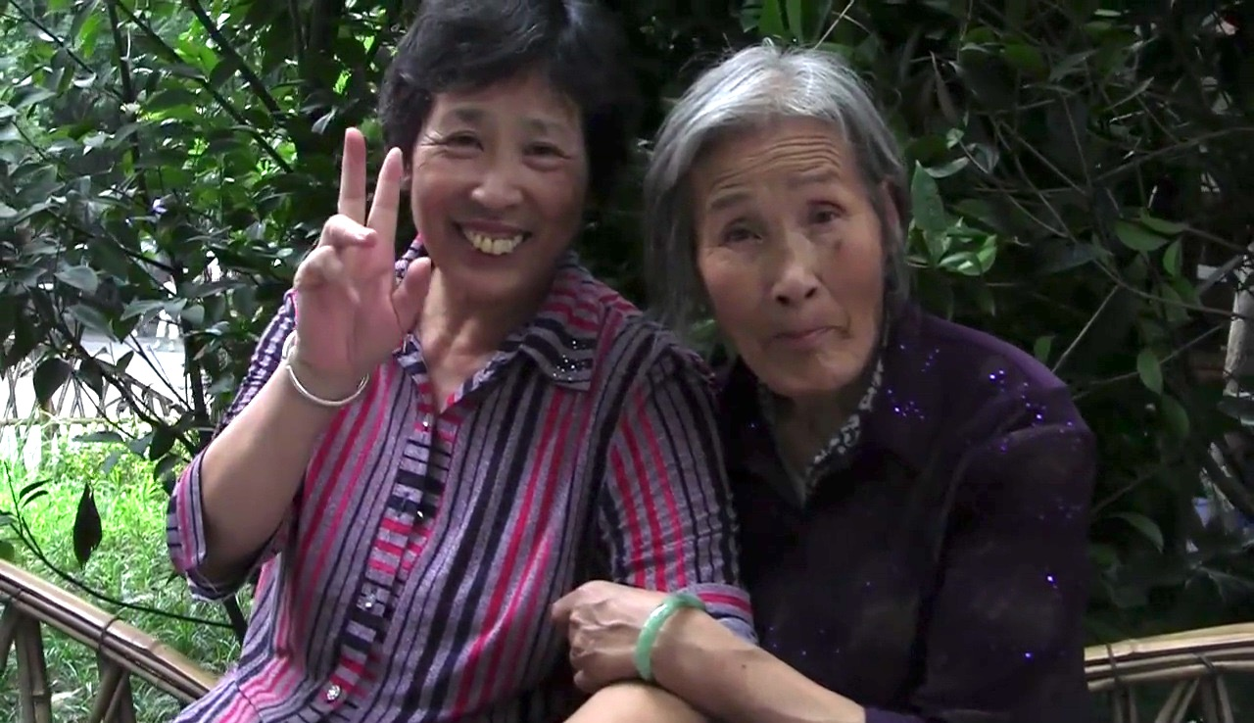
DOCUMENTARY AS SUCH?
DEFINITIONS AND LIMITATIONS

Slide 2
DEFINING DOCUMENTARY
OUR DEFINITIONS (review)
1. A REGISTER/RECORDING of “REAL” HISTORICAL EVENTS (things that actually happened; people that actually existed)
2. The ESTABLISHMENT of a CLEAR RELATIONSHIP between SUBJECT and OBJECT of “documentary situation” (i.e. between the person who documents and the people/places/events documented)
3. The results of an INVESTIGATION into/about something that “really happened” (as opposed to something that never happened… but perhaps could have happened?)
4. The (faithful) ACCOUNT of events/people/places as if they were real/as if they really occurred (i.e. with a high degree of verisimilitude)
> Atenção! Note how this last definition is the one usually applied to fiction when referring to its “realism”
> Hence: already in our own preliminary definitions of documentary, we confront the implicit confusion between documentary and non-documentary

Slide 3
DEFINING DOCUMENTARY
BILL NICHOLS’S DEFINITIONS (review)
1. A "documentary" work refers (directly and explicitly) to actual facts, without modifying them or introducing any new or unverifiable data (things/actions/events)...
2. A "documentary" work represents reality objectively ... (unlike the non-documentary work—i.e. fiction— which represents reality subjectively, i.e. in an interpretive way)
3. A "documentary" work addresses, and reveals, "real people" in their "real contexts"... They are not professional actors, but rather social actors
4. A "documentary" work may "tell a story" about "reality” (i.e. organize the elements of reality into a coherent narrative)… yet that telling is NEVER the INTERPRETATION of reality…
… To the contrary it is the actual history of those "real" events (i.e. documentary = history)

Slide 4
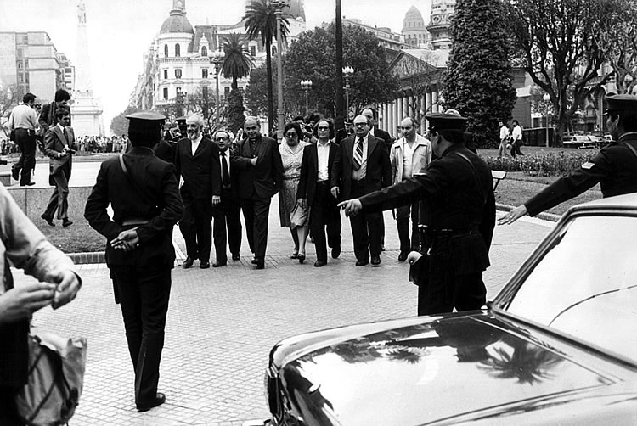
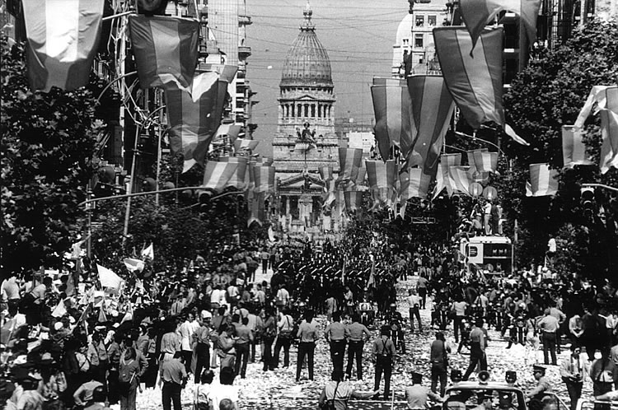
TEST CASES: Documentary? Or not?
EXHIBIT A:
Silvio Zuccheri, Argentinian photographer and photo-journalist
Adolfo Pérez Esquivel and Human Rights representatives making their way to the Casa de Gobierno, March 30, 1982
Inauguration of Raúl Alfonsin, December 10, 1983

Slide 5
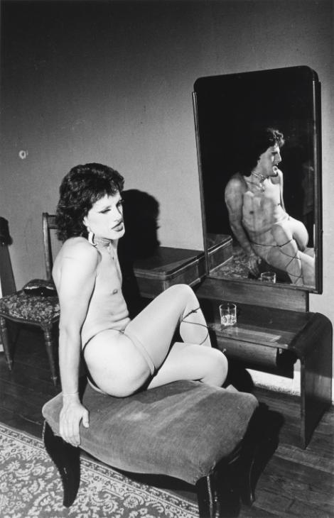
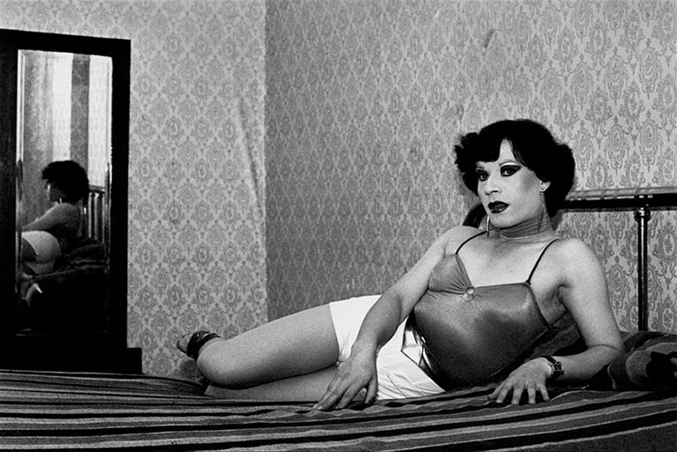
TEST CASES: Documentary? Or not?
EXHIBIT B:
Paz Errázuriz, Chilean photographer (b. 1941, Santiago de Chile)
Evelyn I, Santiago, from the series La manzana de Adán, 1987
Pilar, La Palmera, from the series La manzana de Adán, 1987

Slide 6
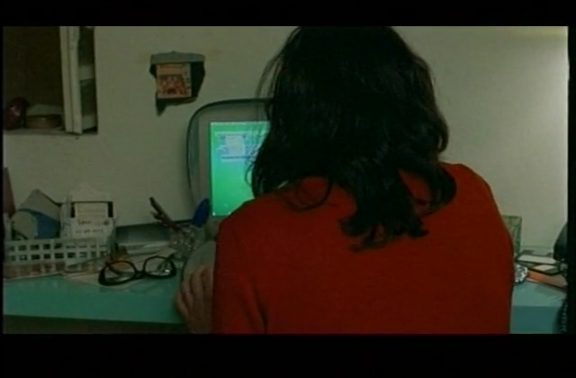
TEST CASES: Documentary? Or not?
EXHIBIT C:
Los rubios, Dir. Albertina Carri (Argentina, 2003)

Slide 7
DISTINGUISHING DOCUMENTARY
Three Ways to Frame the Issue:
• What documentary is
Questions about its distinguishing [intrinsic?] properties: its [unique?] relationship to “reality” and “truth”; its [unique?] formal strategies
• What documentary does
Questions about [unique?] relationship it establishes between apparatus and actor
• What one does with documentaries
Questions about [unique?] relationship it establishes between object (i.e. the documentary work itself) and spectator (i.e. public)

Slide 8
WHAT IS DOCUMENTARY?
Question of nature (ontology) and form (language)
• IS DOCUMENTARY FILM INTRINSICALLY DISTINGUISHABLE FROM OTHER CINEMATIC MODES (especially FICTION FILM)?
(I.e. Does documentary bear a unique/distinct relationship to “reality” and “truth”?)
• IS DOCUMENTARY FORMALLY DISTINGUISHABLE FROM OTHER CINEMATIC MODES (especially FICTION FILM)?
(I.e. Does documentary employ formal techniques/principles of representation that are exclusive/proper to it?)

Slide 9
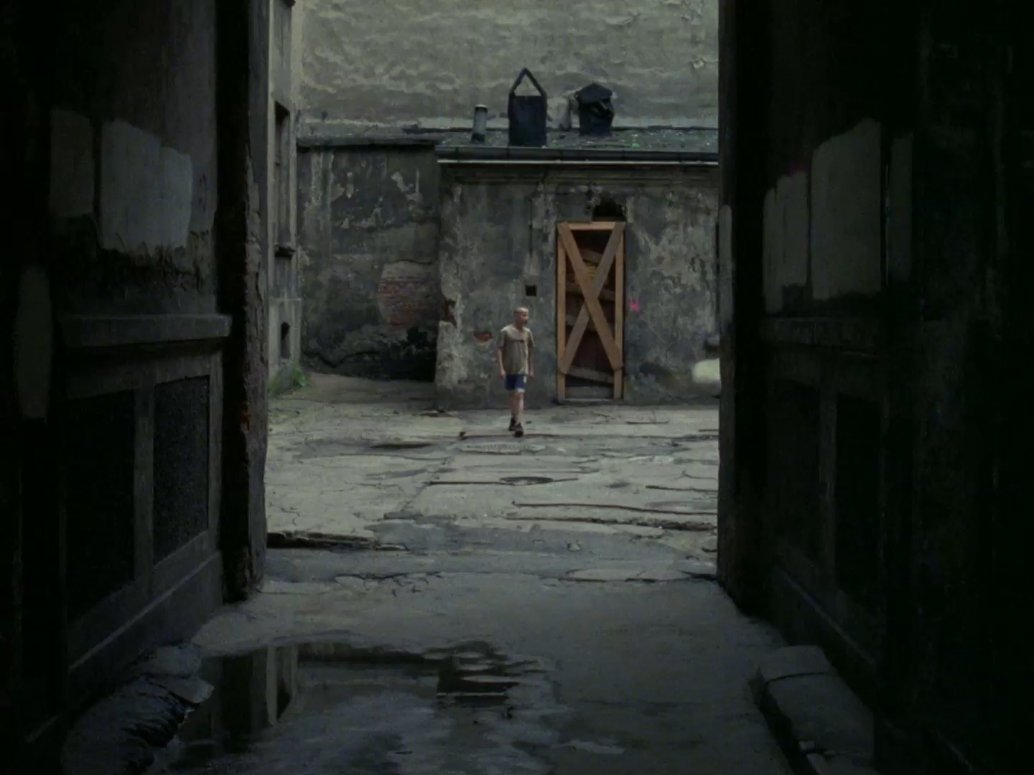
TESTING ONTOLOGICAL AND FORMAL CLAIMS
EXHIBIT A:
Clip from Podwórka, dir. Sharon Lockhart (2009)

Slide 10
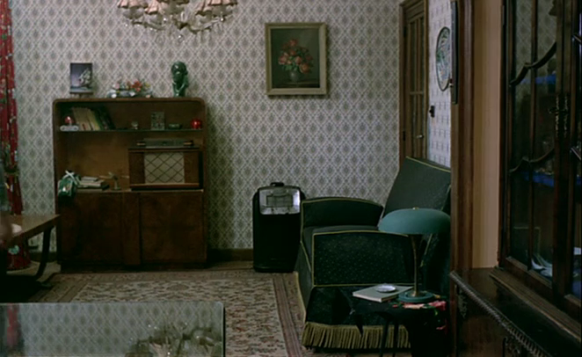
TESTING ONTOLOGICAL AND FORMAL CLAIMS
EXHIBIT B:
Clip from Jeanne Dielman, 23 Quai du Commerce, 1080 Bruxelles, dir. Chantal Akerman (1975)

Slide 11
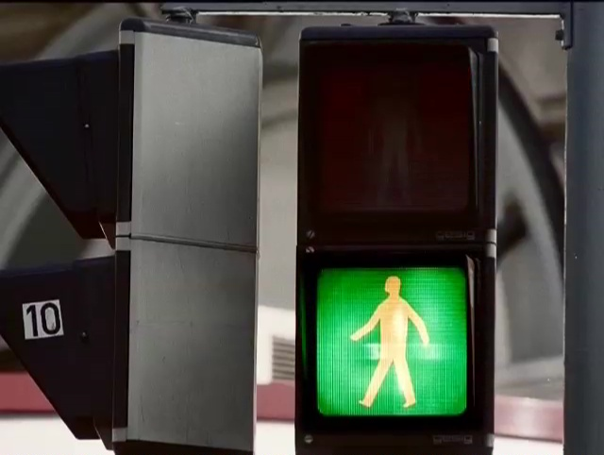
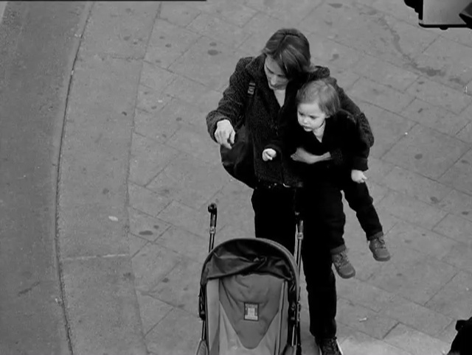
THE FICTION OF DOCUMENTARY…
EXHIBIT C (An Object Lesson):
Worst Case Scenario, dir. John Smith (UK 2003)

Slide 12
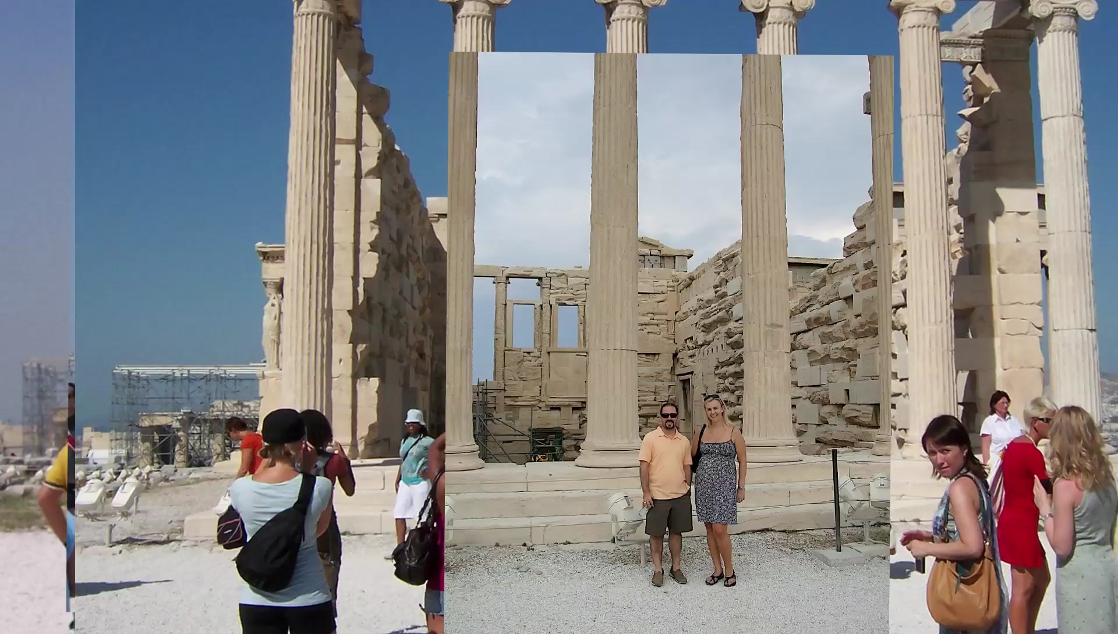
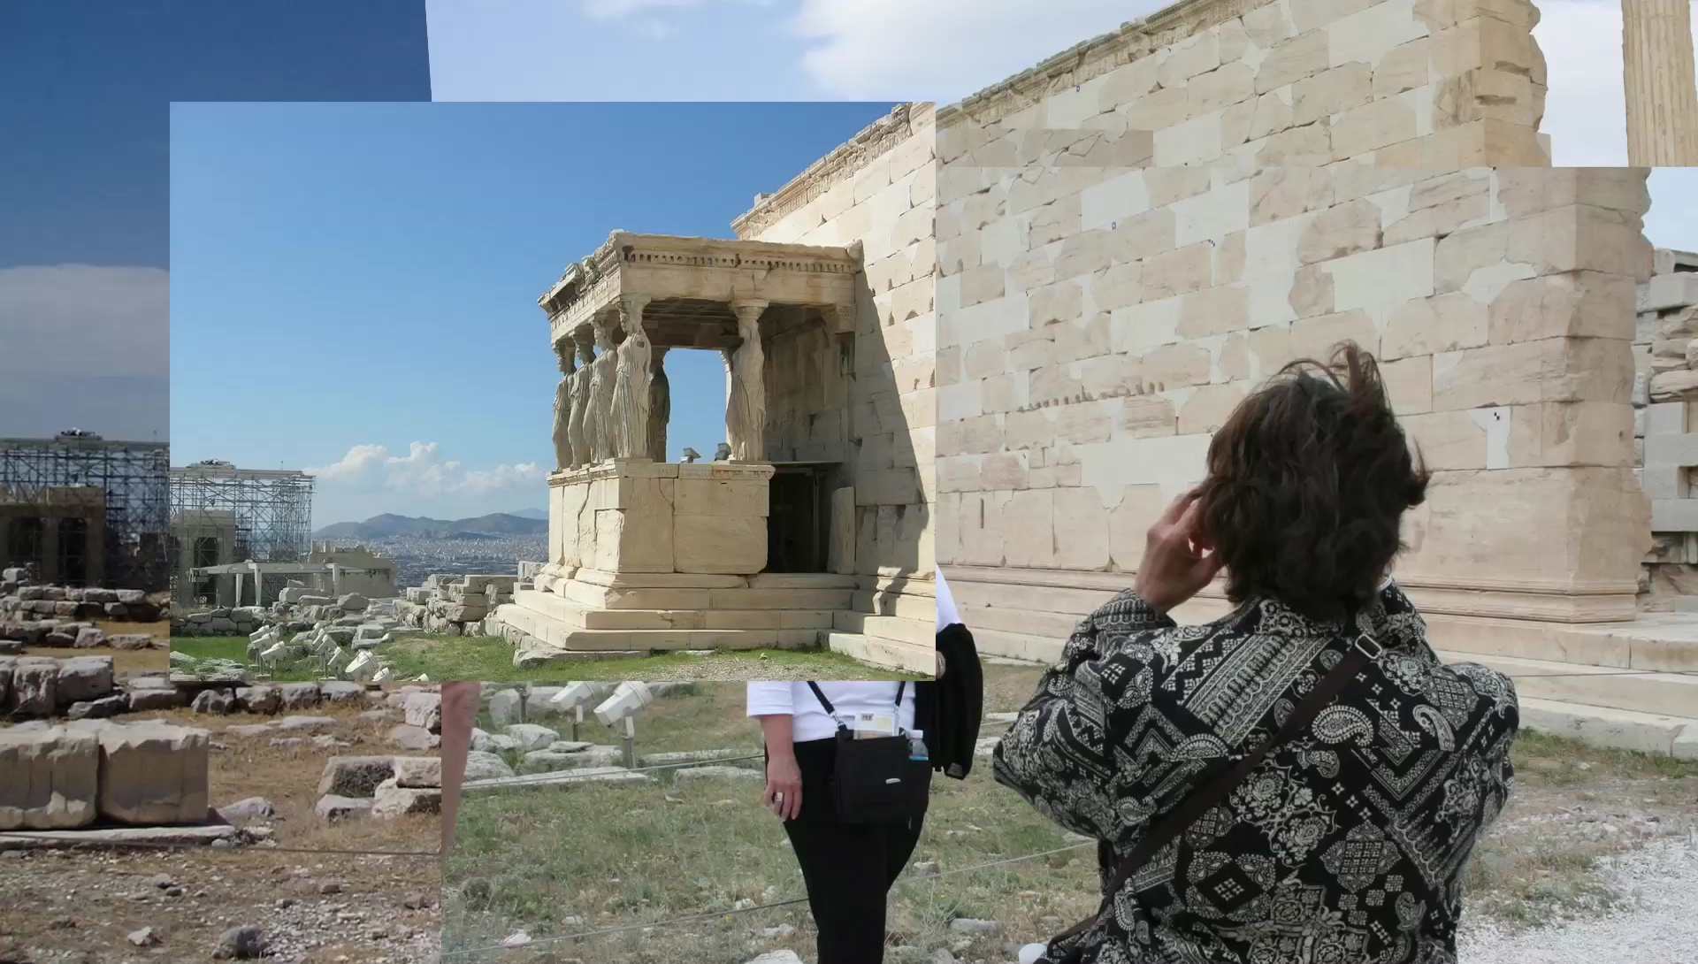
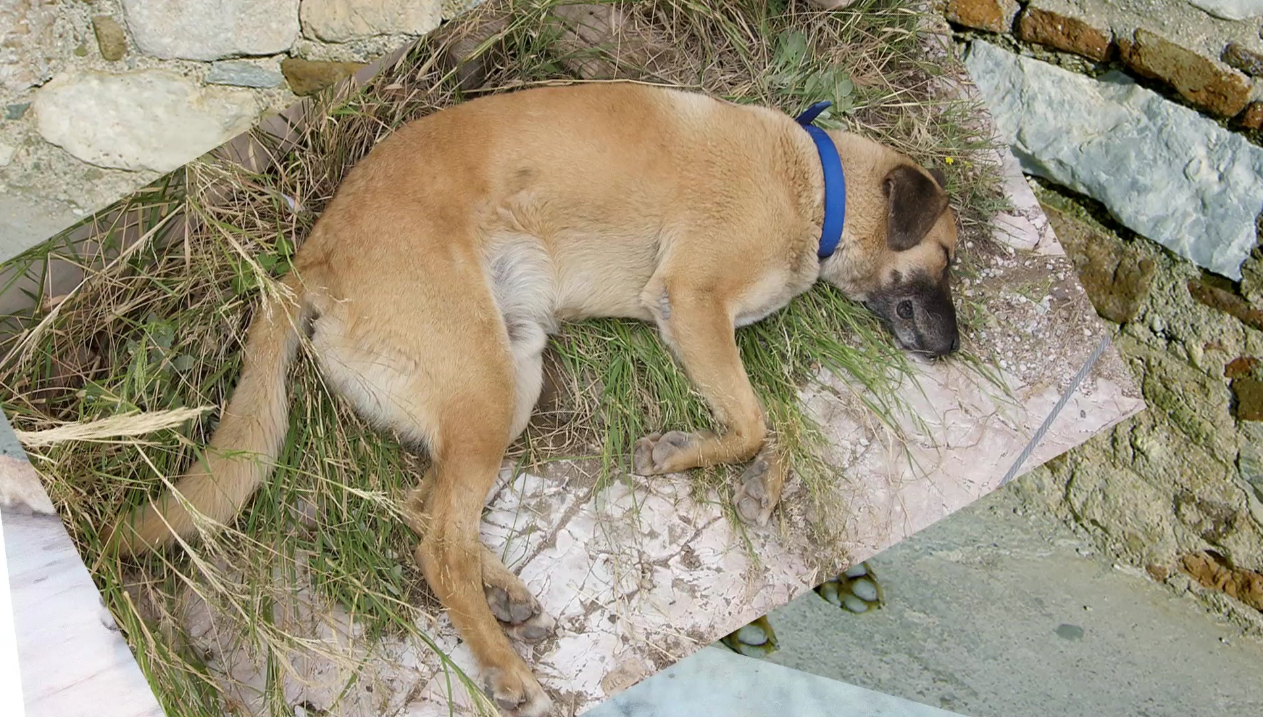
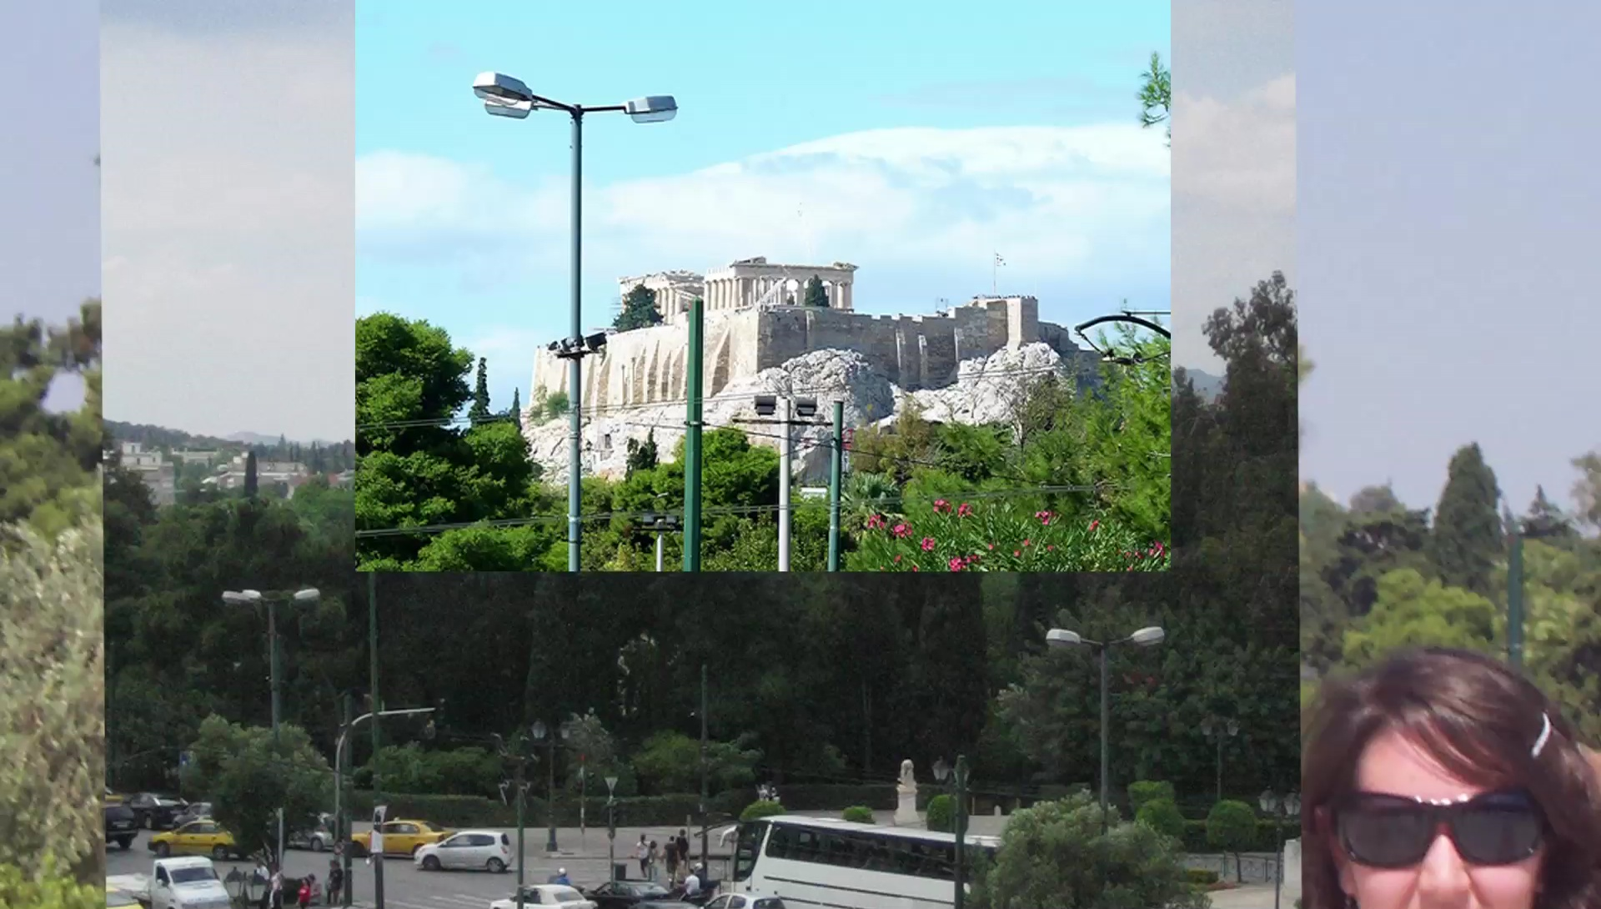
THE FICTION OF DOCUMENTARY…
EXHIBIT D (A documentary with no “subject”?)
A. Flury’s A Place I’ve Never Been

Slide 13
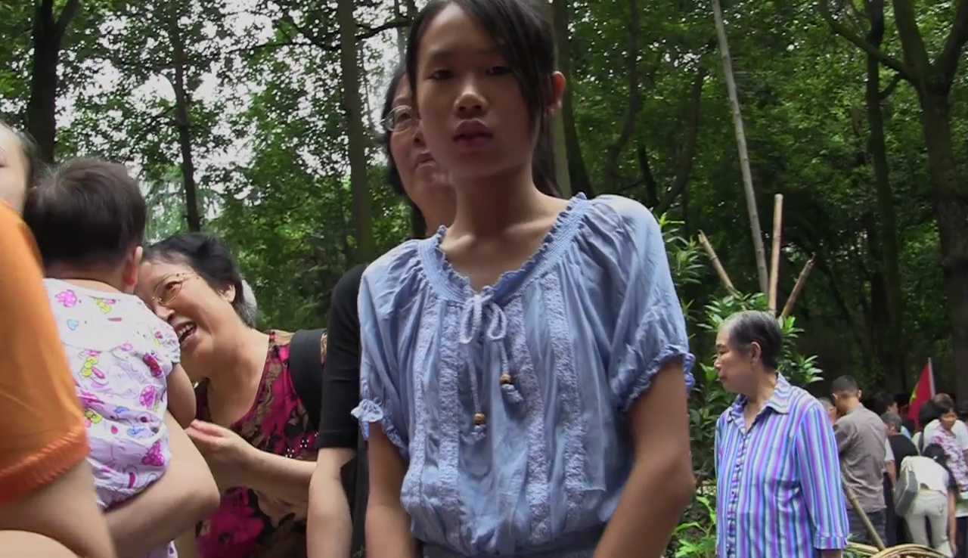
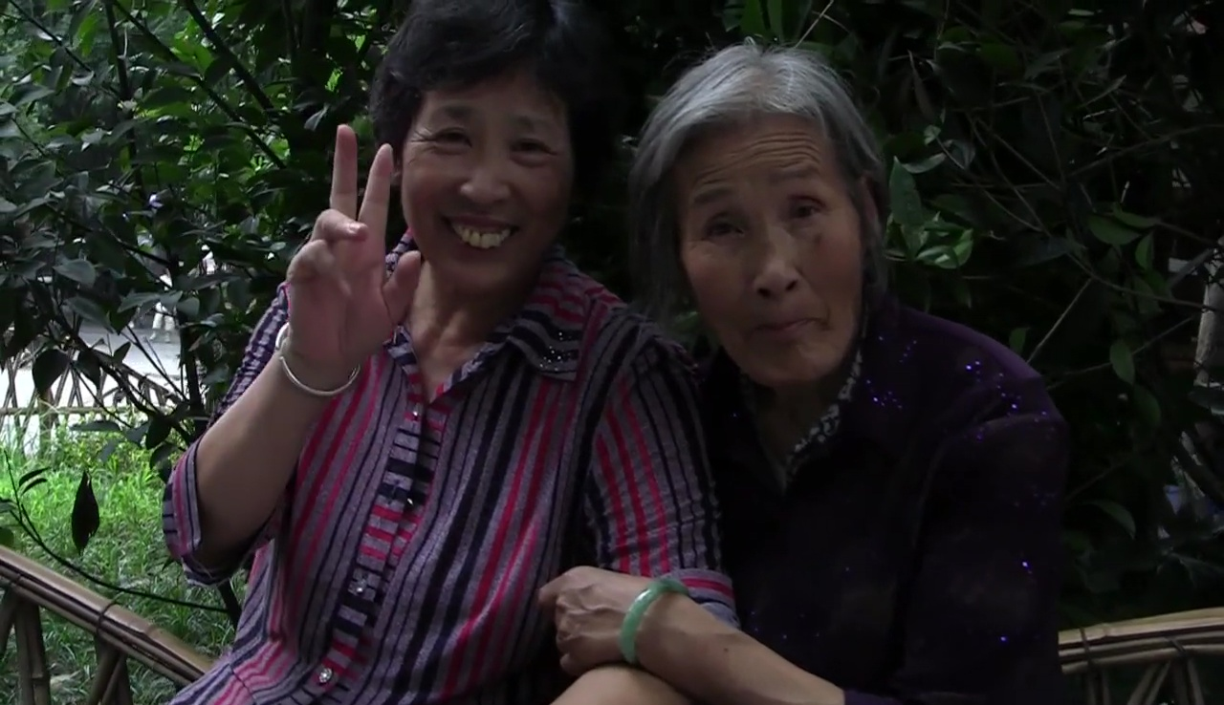
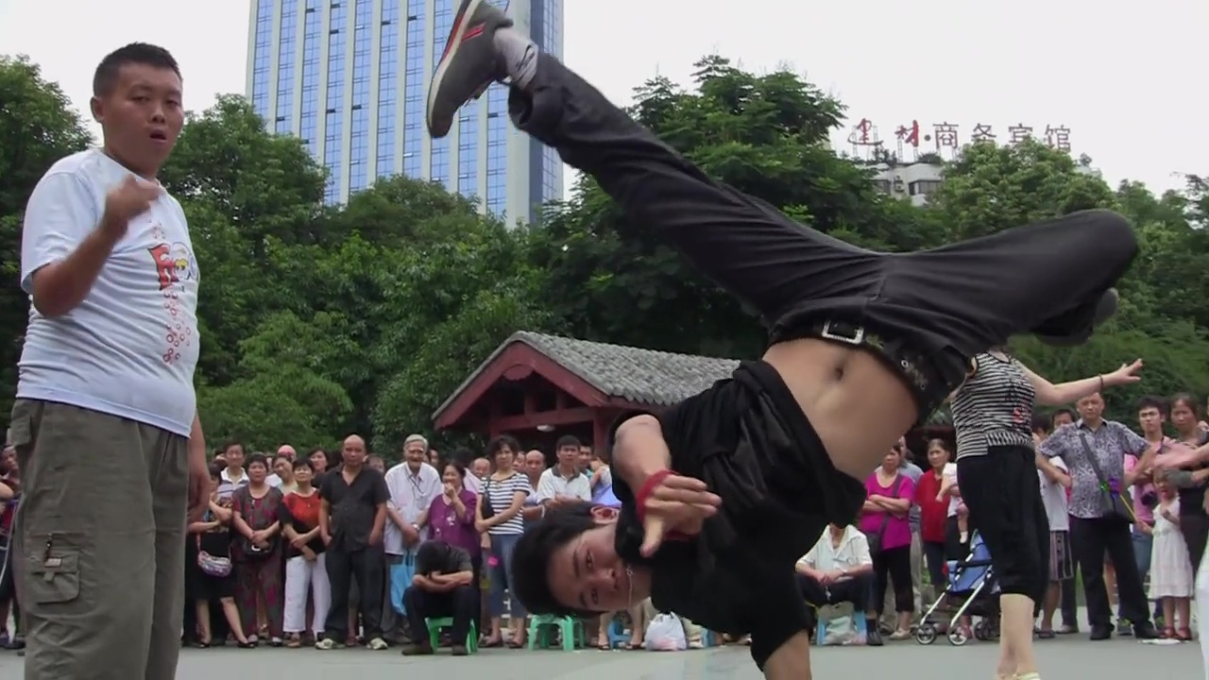
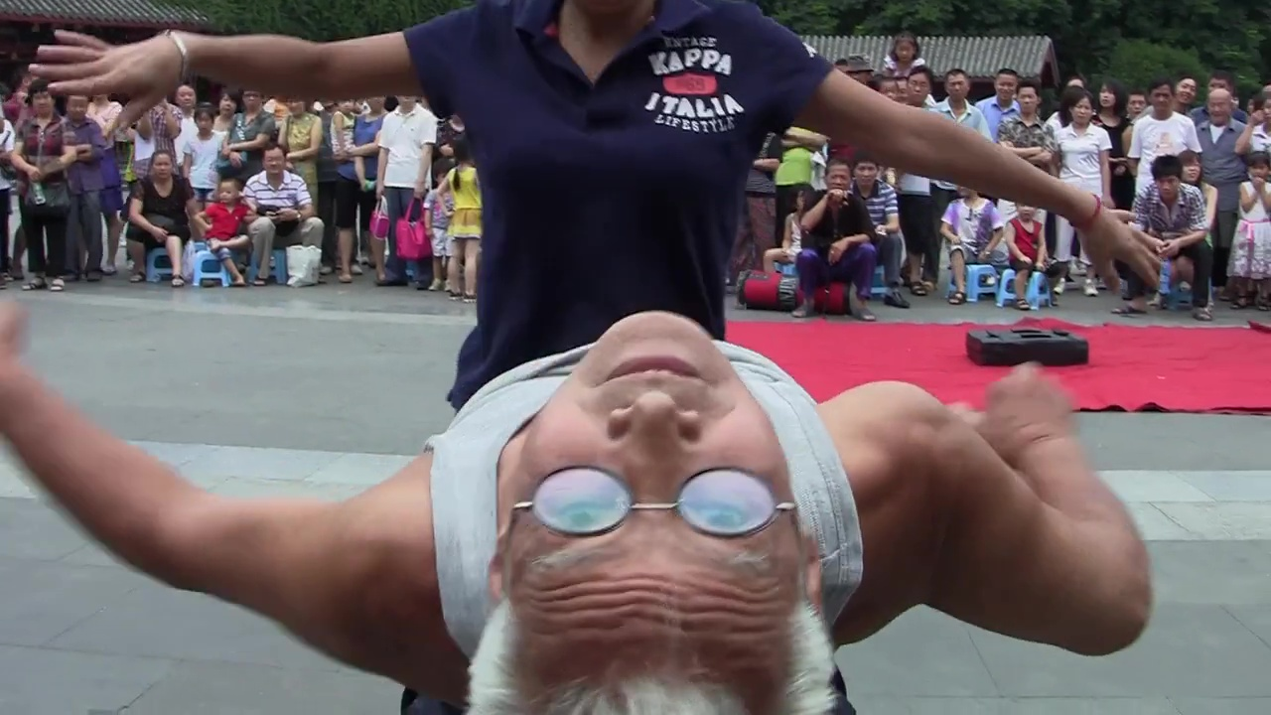
A DOCUMENTARY WITHOUT MONTAGE?
DOCUMENTARY PERFORMANCE AT THE LIMITS OF IMMATERIAL LABOR?
Sniadecki/Cohn’s People’s Park

Slide 14
TOWARDS AN ALTERNATIVE THEORY OF THE OF THE “DIFFERENCE” OF DOCUMENTARY?
Two (possible) grounds on which to distinguish Documentary:
• ETHICAL DISTINCTION
On basis of unique articulation between apparatus (filmmaker, crew, etc.) and protagonist (“social actors”):
AKA the “Documentary Situation”
• POLITICAL DISTINCTION
On basis of particular effects and uses of documentaries, i.e. of unique articulation between spectator (documentary public) and object (completed documentary film)
AKA the “Documentary Common”(?)

Slide 15
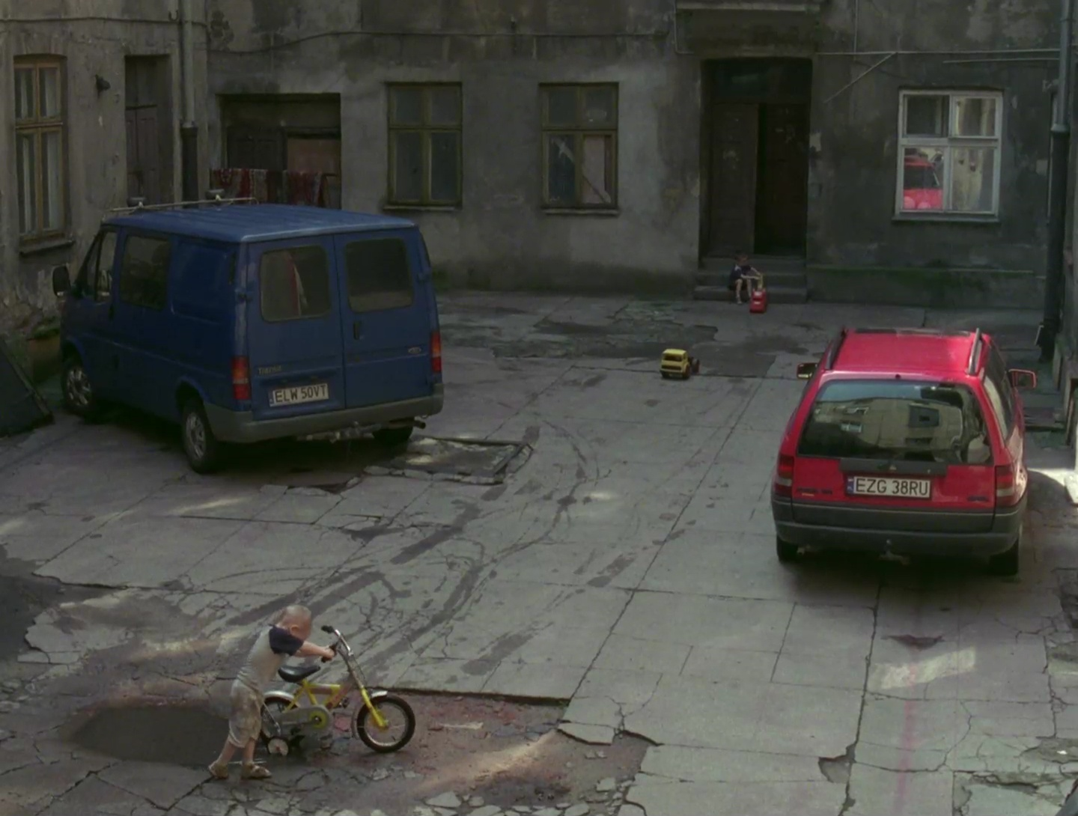
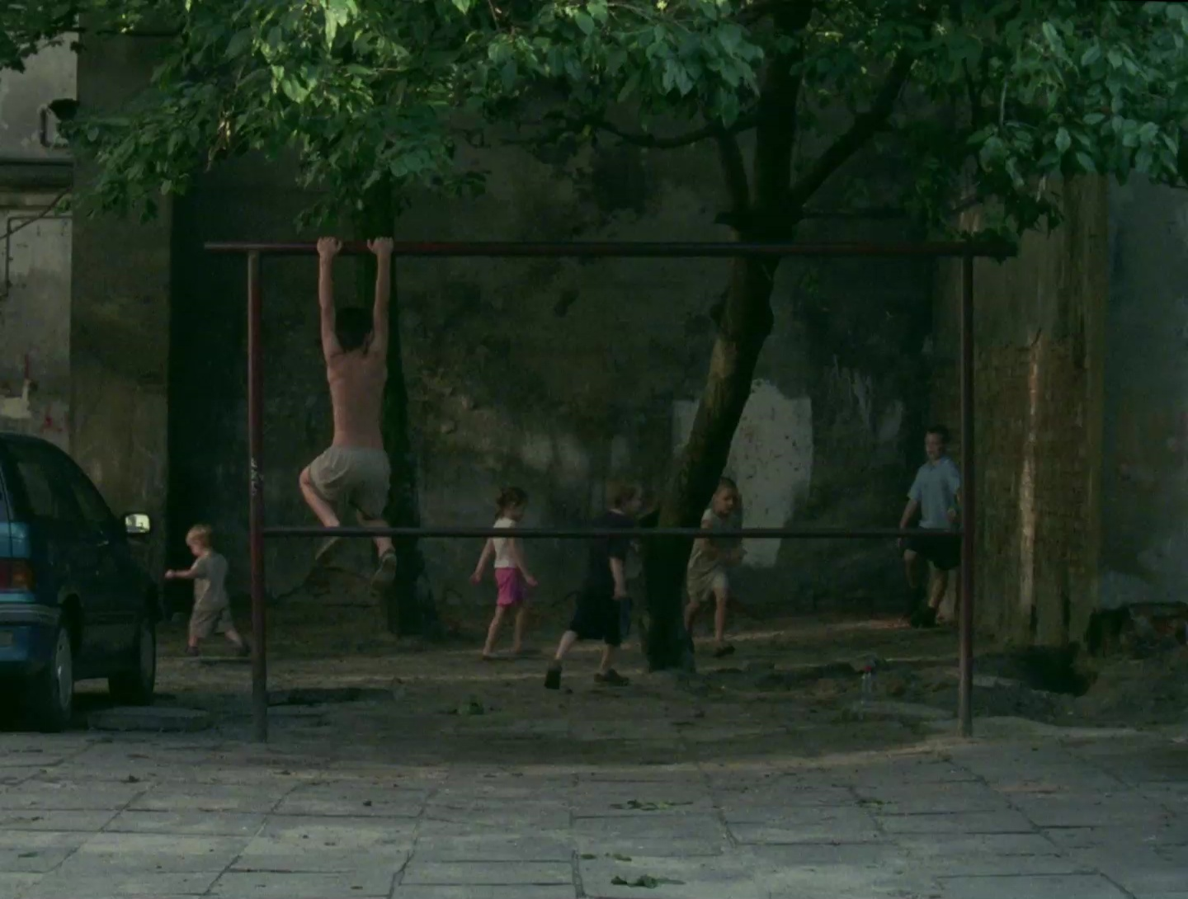
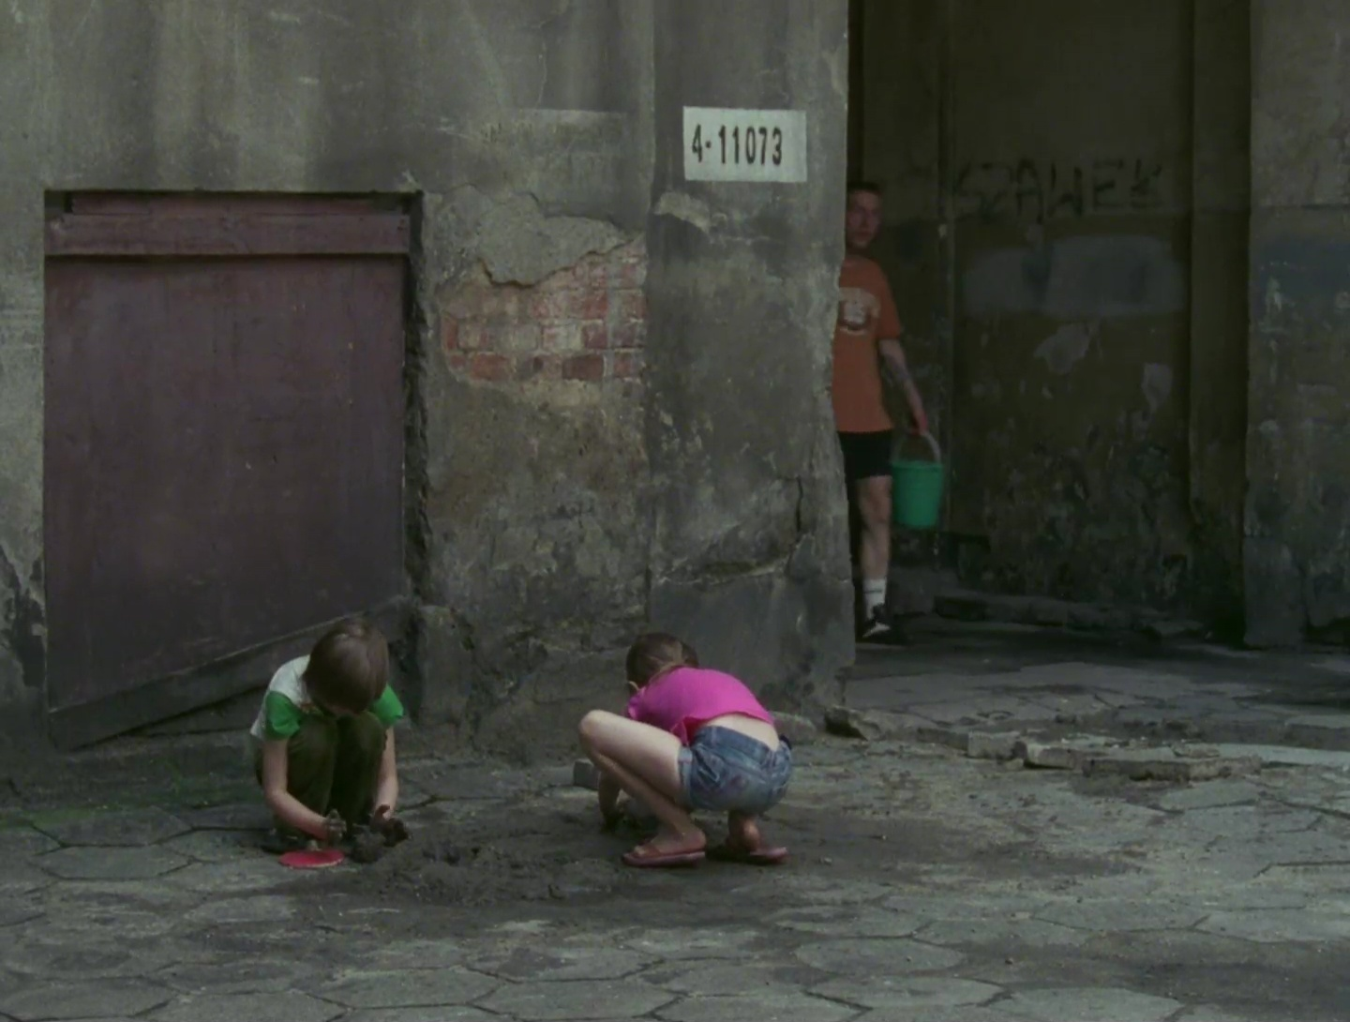
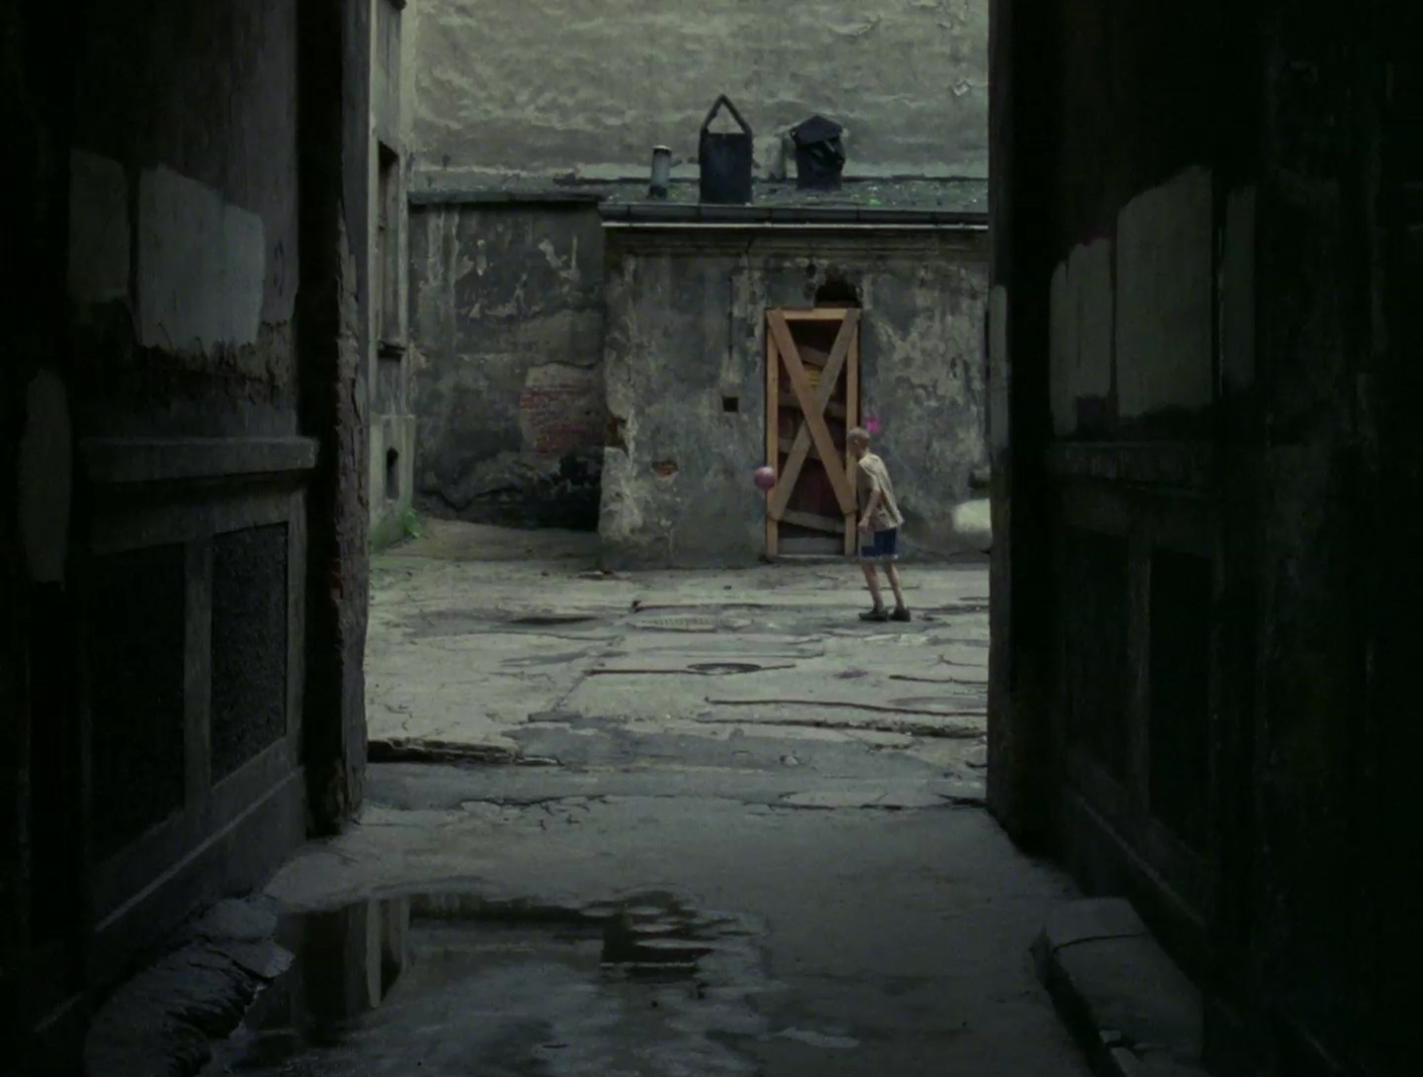
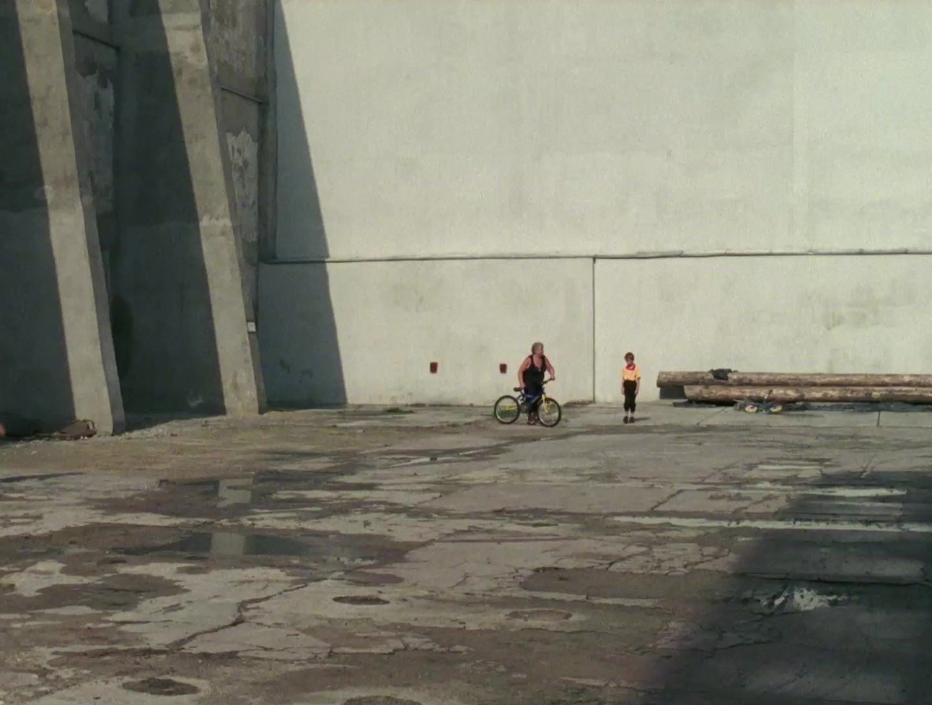
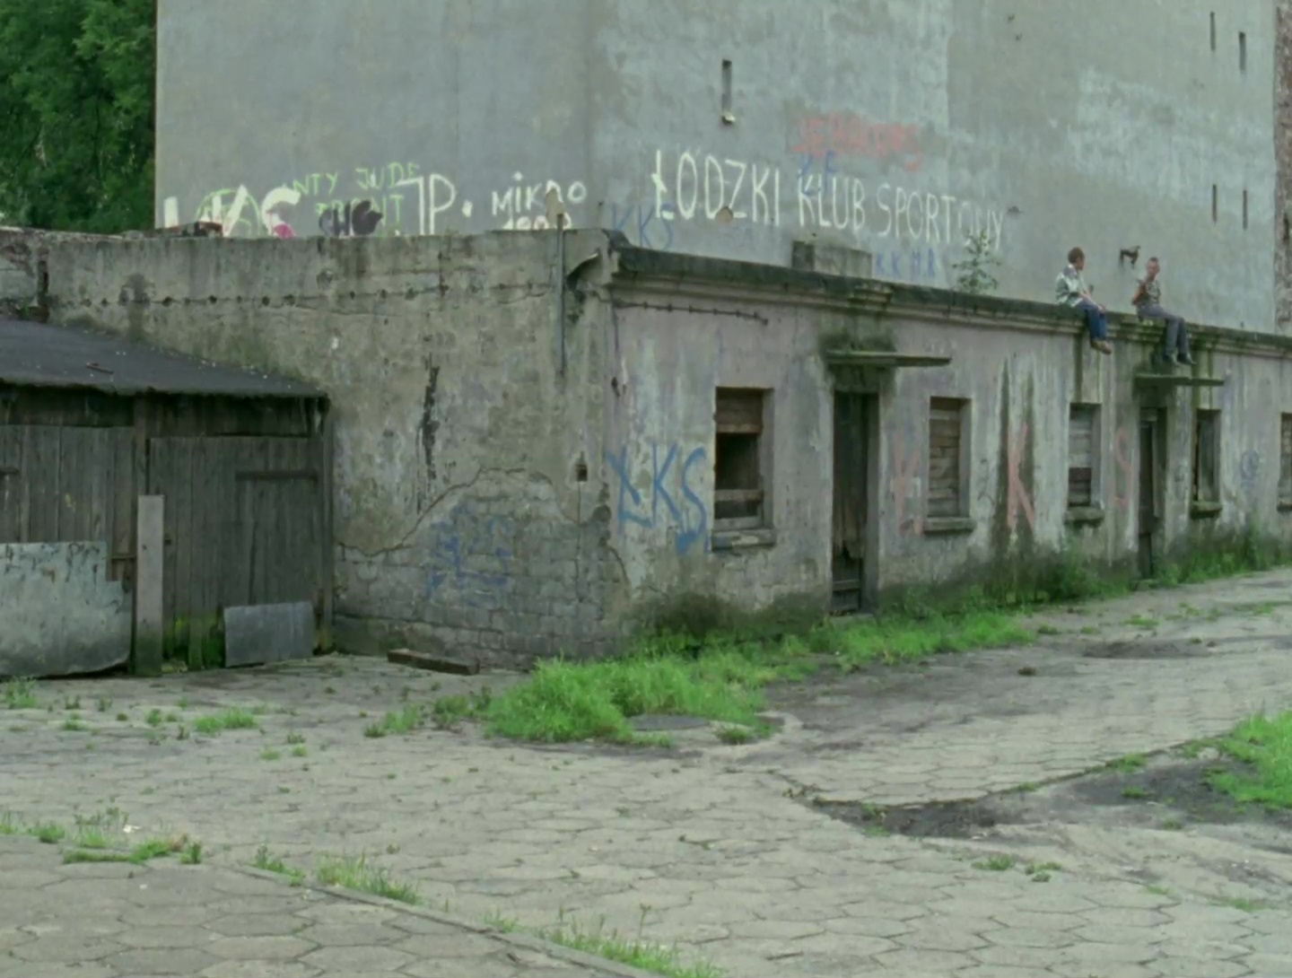
THE “DOCUMENTARY SITUATION” and the ETHICAL DISTINCTION (?)
THE RELATIONSHIP BETWEEN APPARATUS AND DOCUMENTARY ACTORS
LOCKHART’S PODWÓRKA: A “PARADIGMATIC” CASE (?)

Slide 16
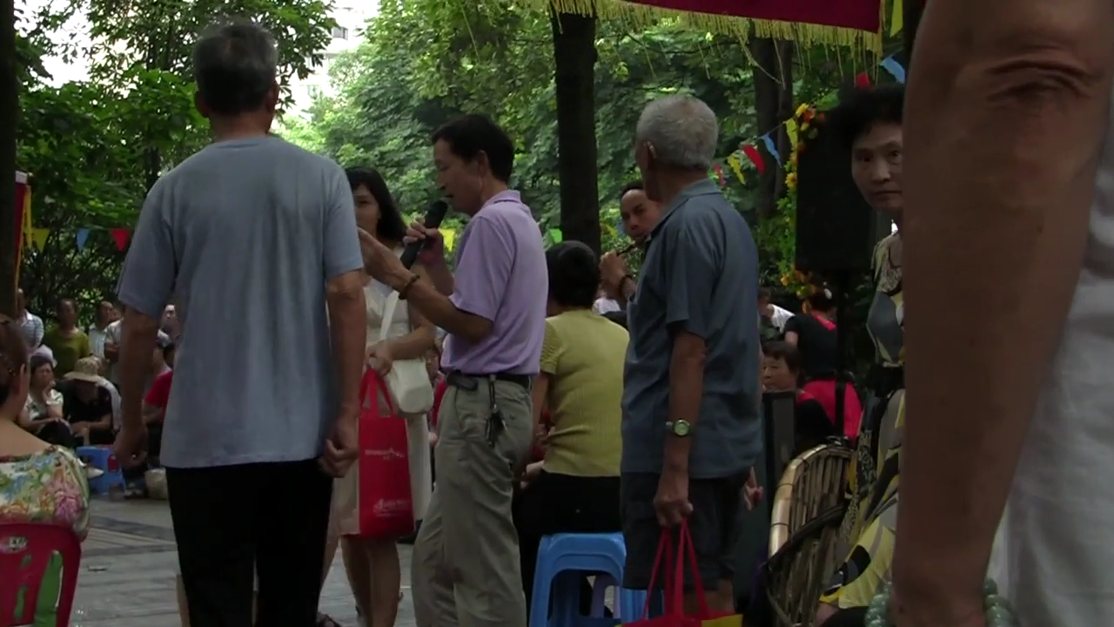
THE “DOCUMENTARY SITUATION” and the ETHICAL DISTINCTION (?)
THE RELATIONSHIP BETWEEN APPARATUS AND DOCUMENTARY ACTORS
SNIADECKI AND COHN’S PEOPLE’S PARK AS “PARADIGMATIC” CASE (?)

