Slide 1
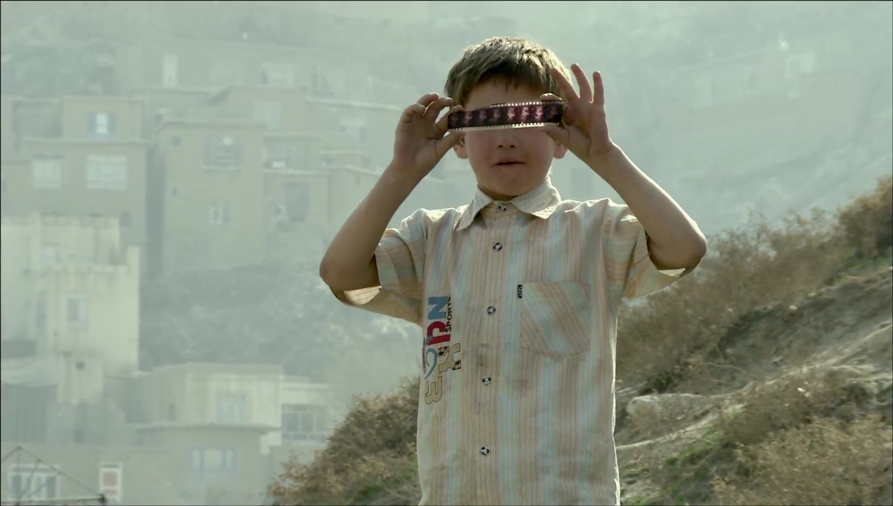
HISTORY, MEMORY, TRUTH, FICTION
CONTEMPORARY DOCUMENTARY PRACTICES
“CULTURE OF VISUALIZATION”
Graduate Program in Education, Art and Cultural History
Universidade Mackenzie
Professors Jane de Almeida and Greg Cohen . janedealmeida@gmail.com gdcohen71@ucla.edu

Slide 2
GENERAL INTRODUCTION:
• Professors Jane de Almeida and Greg Cohen
• Course elements: program, syllabus, structure, themes and concepts
• Some preliminary questions of/on “documentary”

Slide 3
Preliminary Questions: What do we mean when we talk about “documentary”?
* What do we understand by the term “documentary”?
> How does the term “documentary” relate to the term “document” (as both object and act/action)
* Is the practice of documentary the same as that of reporting? Is the news a form of “documentary practice”?
* Can a work of “documentary” be a “work of art”?
* When referring to “documentary practices,” how might we define them or distinguish them from other, “non-documentary” audio-visual practices?

Slide 4
“DOCUMENTARY PRACTICES”
Some provisional and problematic definitions (by way of Bill Nichols):
1. A “documentary work” conveys (directly, explicitly) “real” things/actions/events, without modifying them, or adding to them any “new” or “unverifiable” things/actions/events…
2. A work of “documentary” represents “reality” in an objective way (unlike the “non-documentary” work, which represents reality in a subjective or constructed way)…
3. A “documentary” deals with and shows us “real people” in their “real contexts”; these people are “social actors” rather than “professional actors”…
4. A work of “documentary” may “tell a story” about “reality,” but that “telling” is not the interpretation of real events, but rather “the actual story” of the unfolding of those events

Slide 5
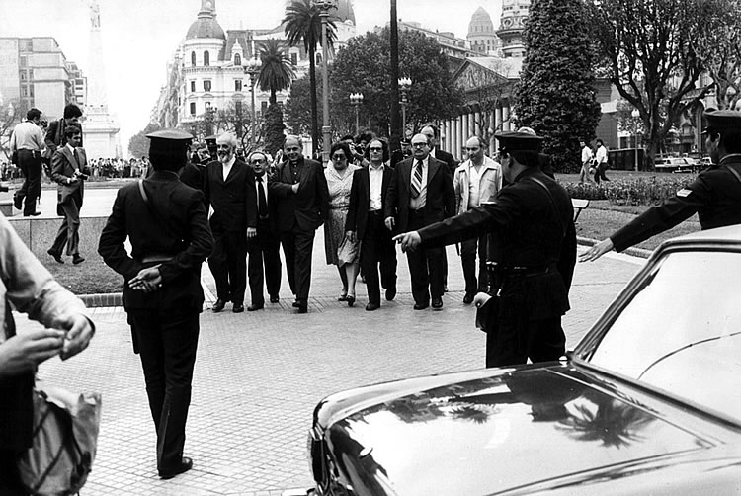
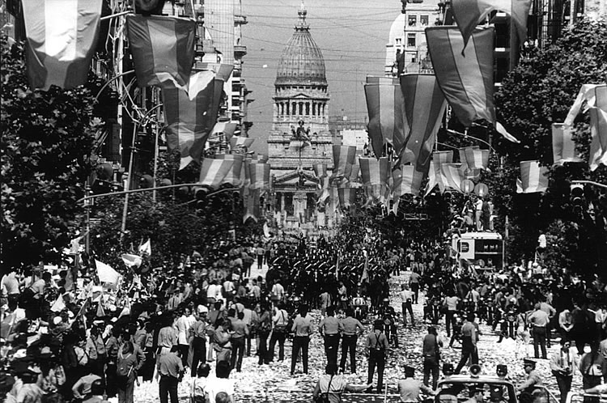
COMPLICATING THE QUESTION [¿DOCUMENTARY… OR NOT?]
EXHIBIT A:
Silvio Zuccheri, Argentinian photographer and photo-journalist
Adolfo Pérez Esquivel and Human Rights representatives making their way to the Casa de Gobierno, March 30, 1982
Inauguration of Raúl Alfonsin, December 10, 1983

Slide 6
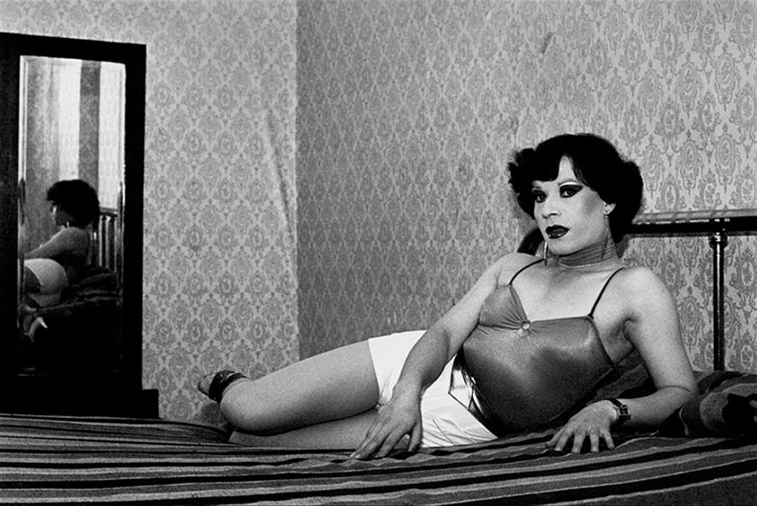
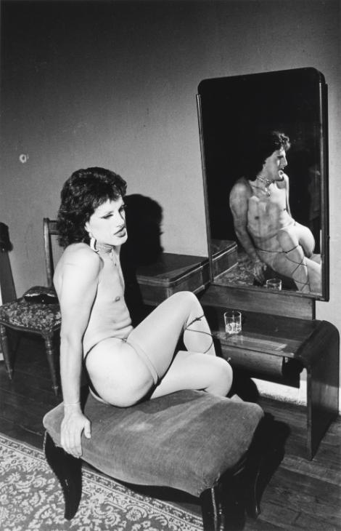
EXHIBIT B:
Paz Errázuriz, Chilean photographer (b. 1941, Santiago de Chile)
Evelyn I, Santiago, from the series La manzana de Adán, 1987
Pilar, La Palmera, from the series La manzana de Adán, 1987

Slide 7
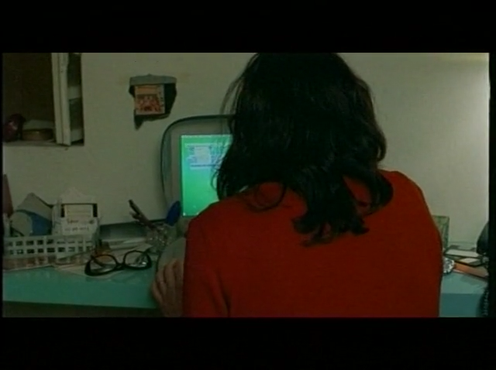
EXHIBIT C:
Los rubios, dir. Albertina Carri (Argentina, 2003)

